Slide 1
Credit Management
December 8, 2020

Slide 2
In Partnership with:

Slide 3
Objectives
Define Credit
Define Credit Report
Advantage and Disadvantage of Credit
3 Major Credit Bureaus
Define Credit Score
How to Dispute Errors on Your Credit Report
How to Build a Better Credit Report
How to Choose a Credit Counselor
Notes:
Read Slide
1 minute

Slide 4
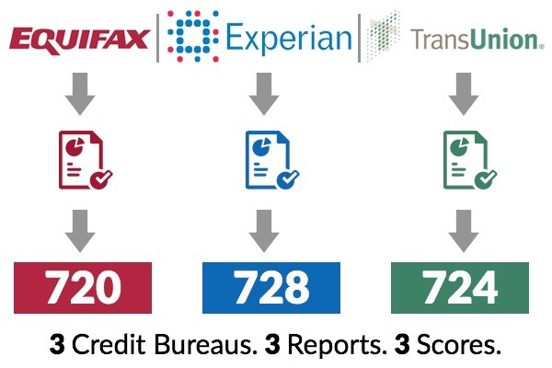
Credit
What is Credit?
What is a Credit Report?
What are the three nationwide credit reporting companies?
How do you order a free report?
https://images.bestcompany.com/wp-content/uploads/sites/103/2015/09/3Reports1.jpg
Notes:
Read and Explain Slide
What is credit ?
The ability to borrow money with the agreement to pay it back at a later date.
What is a credit report?
A credit report includes personal information on where you live, how you pay your bills, whether you’ve sued or filed bankruptcy.
Nationwide credit reporting companies sell your information in your report to creditors, insurers, employers, and other business who uses it to evaluate your application for credit, insurance, employment
What are the three nationwide credit reporting companies?
Equifax
TransUnion
Experian
How do you order a free report?
The three nationwide credit reporting companies have set up a central website, a toll free telephone number and a mailing address in which you can obtain your credit report
Website: www.annualcreditreport.com
Telephone number: 1-877-322-8228
Mail: Annual Credit Report, P.O. Box 105281, Atlanta, GA 30348-5281
2 minutes

Slide 5
Free Credit Report
Online: Visit annualcreditreport.com
By Phone: Call 1.877.322.8228
By Mail: Credit Report Request
P.O. Box 105281
Atlanta, GA 30348-5281
Experian : experian.com/ 1.888.397.3742
Equifax: equifax.com / 1.800.685.1111
TransUnion: transunion.com /1.800.888.4213
Notes:
Read and Explain Slide
1 minute

Slide 6
Credit Facts-2020
The average American's credit card balance is $6,194 as of the second quarter of 2019.
Total credit card balances in the United States are $893 billion as of the first quarter of 2020.
Americans are collectively using 23% of their available credit limit.
Americans currently have 511.4 million credit cards.
61% of American consumers have at least one credit card, and the average person has four.
Approximately 9.1% of all credit card balances in the United States were 90 days or more delinquent as of the first quarter of 2020.
Notes:
Read and Explain Slide
1 minute

Slide 7
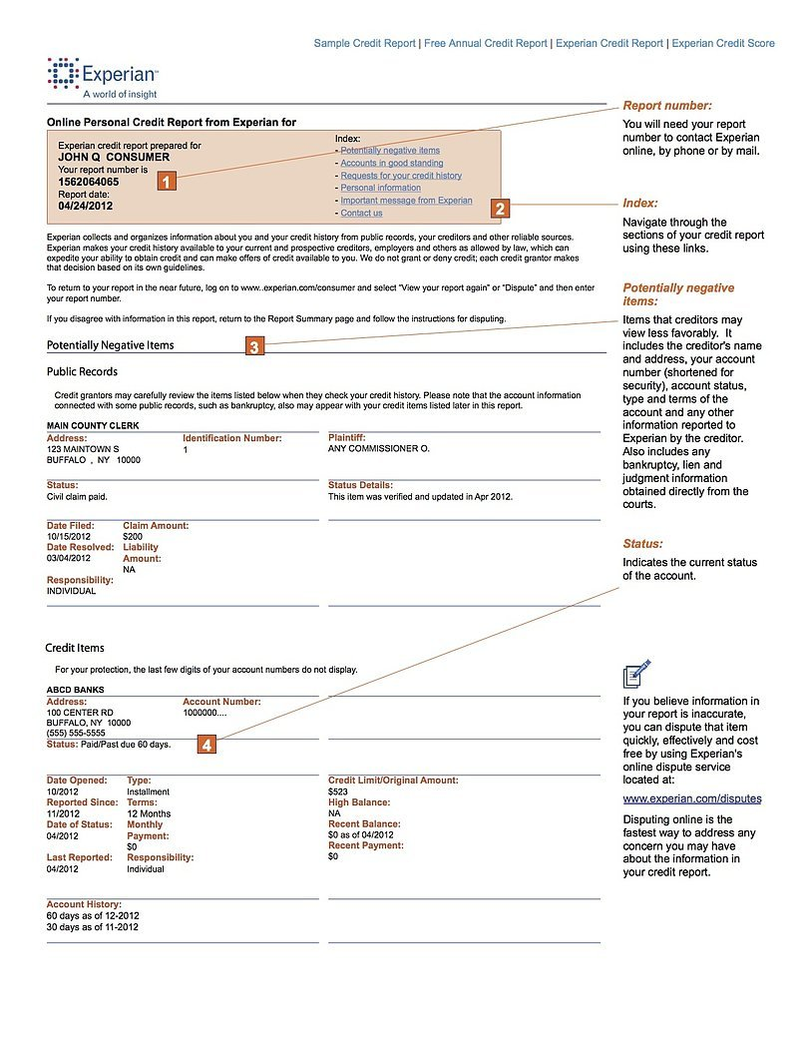
Sample Credit Report
Notes:
Read and Explain Slide
Explain what’s on the sample report
Sample Credit Report
A credit report is a record of your credit activities. It lists any credit-card accounts or loans you may have, the balances, and how regularly you make your payments. It also shows if any action has been taken against you because of unpaid bills.
2 Minutes

Slide 8
What are the Advantages & Disadvantages?
Advantages to Credit
Disadvantages to Credit
Notes:
Read and Explain Slide
Advantages
Able to buy needed items now
Don’t have to carry cash
Creates a record of purchases
More convenient than writing checks
Consolidates bills into one payment
Advantages
Interest (higher cost of items)
May require additional fees
Financial difficulties may arise if one loses track of how much has been spent each month
Increase impulse buying may occur
1 Minute

Slide 9
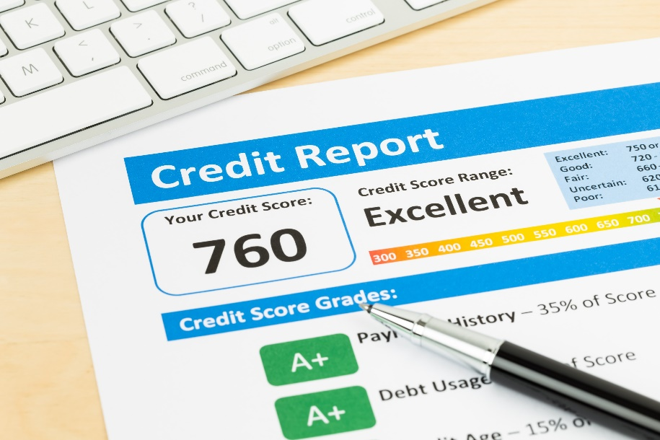
Free Credit Report
What information do you need to provide to get a free report?
Why do you want a copy of your report?
How long does it take to get a report after you order it?
Are there other situations where you might be eligible for a free report?
Notes:
What information do you need to provide to get a free report?
Provide name, address, SSN, and DOB
If you have moved in the last 2 years, provide your previous address
The nationwide credit reporting company may ask you questions only you can answer
Why do you want a copy of your report?
To make sure the information is accurate, complete and up to date prior to applying for a loan
How long does it takes to get a report after you order it ?
Online-Immediately access
Telephone- Process and mail within 15 days
Mail: process and mail within 15 days of receipt
Are there other situations where you might be eligible for a free report?
Under federal law you are entitled to a free credit report if you are denied of credit, insurance or employment or if you’re looking for a job within the 60 days, receiving welfare, a victim of fraud or identity theft.
You have 60 days to request for a report
There is a fee for additional reports
2 Minutes

Slide 10
Free Credit Report
Should you order a report from each of the three nationwide credit reporting companies?
Should you order from all three nationwide credit reporting companies at the same time?
What if you find errors, either inaccuracies or incomplete information, in your credit report?
Notes:
Read and Explain
Should you order a report from each of the three nationwide credit reporting companies?
Your decision, but I would say yes because
Nationwide credit reporting companies get information from different sources
Information may or may not be the same
Should you order your report from all three of the nationwide credit reporting companies at the same time?
Your decision, but I say no because to keep up with accuracy and information on your report.
What if I find errors, either inaccuracies or incomplete information, in your credit report?
Under the Fair Credit Reporting Act(FCRA) both the credit reporting company and the provider of information are responsible for correcting inaccurate of incomplete information on your credit report.
You must request in writing with the information which is inaccurate
Must be investigated items within 30 days unless they dispute your claim
1 Minute

Slide 11
Free Credit Report
What can you do if the credit reporting company or information provider will not correct the information you dispute?
How long can a credit reporting company report negative information?
Notes:
Read and Explain Slide
What can you do if the credit reporting company or information provider will not correct the information you dispute?
Request for a statement to be placed in your file for future references
You can request for your statement be provided to anyone who has recent received you credit report. (FEE)
Always provide a copy of your dispute letter when applying for credit if the item is not removed from your credit report.
How long can a credit reporting company report negative information?
Negative information – 7years Bankruptcy = 10 years
No limit on reporting information about criminal convictions, jobs that pays more than 75k, 150K life insurance
Lawsuit/unpaid judgement-7years
1 Minute

Slide 12
Free Credit Report
Can anyone else get a copy of your credit report?
Can your employer get a copy of your credit report?
What to look for on your credit report
Notes:
Read and Explain Slide
Can anyone else get a copy of your credit report?
Creditors
Insurers
Employers
Other businesses
that uses your information to determine credit
Can your employer get a copy of your credit report?
Yes, only with your permission
What to look for on Your Credit Report …..
Inquiries
Incorrect Address
Employment
Inactive Accounts with Activity
Accounts You Are Unaware You Have
Unexpected Public Records
Unexpected Derogatory Information
1.5 Minutes

Slide 13
Credit History
What is your credit history?
What your payment history includes
Notes:
Read and Explain Slide
What is your credit history.
Your credit history describes how you use money:
How many credit cards do you have?
How many loans do you have?
Do you pay your bills on time?
If you have a credit card or a loan from a bank, you have a credit history. Companies collect information about your loans and credit cards.
Companies also collect information about how you pay your bills. They put this information in one place: your credit report.
What Your Payment History Includes:
Number of accounts paid as agreed
Negative public records or collections
Delinquent accounts:
total number of past due items how long you've been past due how long it's been since you had a past due payment
2 Minutes

Slide 14
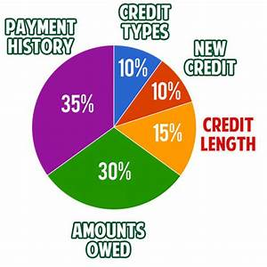
Credit History
Which parts of a credit history are most important?
https://bettercreditblog.org/wp-content/uploads/2012/07/credit-score-breakdown.jpg
Notes:
Read and Explain Slide
Which parts of a credit history are most important?
35% - Your Payment History
30% - Amounts You Owe
15% - Length of Your Credit History
10% - Types of Credit Used
10% - New Credit
1 Minute

Slide 15
Credit Scores
What is credit score?
What is considered as a good credit score?
http://www.yourcreditnetwork.com/images/credit-score-chart.gif
Notes:
Read and Explain Slide
What is credit score?
Credit Score is a number (FICO Score) that helps evaluate how much of a risk it is to lend you money.
FICO = Fair Isaac Company (ranges between 300 and 850)
A credit score help determine your creditworthy
What is considered as a good credit score?
584 or below =Poor
670-699 = Fair
700-729 = Good
730+ = Excellent
1 Minute

Slide 16
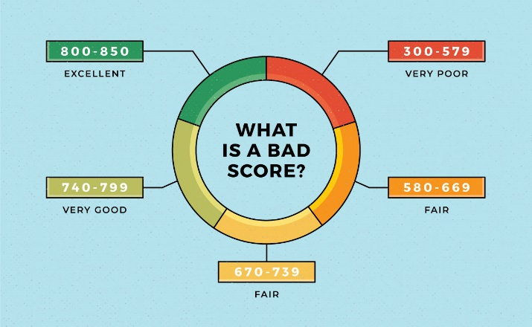
Credit Scores
What can you do to improve your credit score?
What if you are denied credit or insurance, or do not receive the terms you want?
https://turbo.intuit.com/blog/wp-content/uploads/2018/12/What-is-a-Bad-Credit-Score-1.jpg
Notes:
Read and Explain Slide
What can you do to improve your credit score?
Pay your bills on time
Pay off debt and keep balances low
Apply for credit only when needed
Do not close unused credit cards
Dispute any inaccuracies on your credit report
What if you are denied credit or insurance, or do not receive the terms you want?
Creditors must give you a written letter for reasons denied within 60 days
1 Minute

Slide 17
Disputing Errors on Your Credit Report
Correcting errors
Your credit file
Notes:
Read and Explain Slide
Correcting Errors
Step one
Report inaccurate information in writing to the nationwide reporting companies (provide supporting documentation)
Certified Mail
Step two
Report inaccurate information in writing to the information provider (provide supporting documentation)
Your credit file
Always keep your personal file with copies of
Credit reports
Dispute letters
Police reports

Slide 18
Fixing Your Credit
What makes your credit good or bad?
What happens if there is negative information on your credit report?
How do I know what’s in my credit report?
Notes:
Read and Explain Slide
What makes your credit good or bad?
Whether you pay your bills on time
What loans and credits cards you have and the balances
Whether you’ve been sued or arrested
What happens if there is negative information on your credit report?
Could prevent you from getting a loan
Pay more interest
Denied (job, insurance, etc.)
How do I know what’s in my credit report?
Each nationwide credit bureaus is required to provide a free copy once a year
Additional copies requires a fee
1.5 Minutes

Slide 19
Fixing Your Credit
What happens if a company takes a negative action against you because of something in your credit report?
What if I see a mistake on my credit report?
How do I dispute mistakes on my credit report?
Notes:
Read and Explain Slide
What happen if a company takes a negative action against you because of something in my credit report?
You are entitled to another credit report (60 days)
Company must send a notice of the information provider with contact information
What if I see a mistake on my credit report?
You can dispute any inaccurate, incomplete information on your credit report
How do I dispute mistakes on my credit report?
Always dispute in writing to the nationwide credit companies
1 Minute

Slide 20
Credit Repair
What is a credit repair company?
Is using a credit repair company a good idea?
What if you pay a credit repair company and it doesn’t live up to its promises?
How do you know if you are dealing with a credit repair scam?
Notes:
Read the slide
Ask the participants, how many of them have tried to get their credit repaired and did it work?
Allow 2-3 participants to answer
What is a credit repair company?
People can hire credit repair companies to help them investigate mistakes on their credit reports.
Credit repair companies can not remove negative information that’s accurate.
Is using a credit repair company a good idea?
Yes, as long as they are legally and can be done at no cost.
What if you pay a credit repair company and it doesn’t live up to its promises?
The company can be sued in federal court
Seek punitive damage (money to punish the company for violating the law)
Join others in a class action lawsuit against the company
How do you know if you are dealing with a credit repair scam?
Insists you pay before you are provided service
Tells you not to notify the credit bureaus directly
Tell you to dispute information on your credit report that you know is accurate
Tell you to be dishonest about your application for credit or loan
Fail to explain your legal rights
2.5 Minutes

Slide 21
Credit Repair
Where do you report a credit repair scam?
How can your credit report affect your job?
Notes:
Read and Explain Slide
Where do you report a credit repair scam?
State Attorney General Office
550 High Street
Jackson, Mississippi 39205
601-359-3680
Federal Trade Commission (FTC)
1877-FTC-HELP
How can your credit report affect your job?
When applying for a job, employers look at the application you complete and the resume you prepare. Some employers also check into your background before they hire you. Depending on the employer and the job, that background information might include your employment history, driving record, criminal records, and credit report
1 Minute

Slide 22
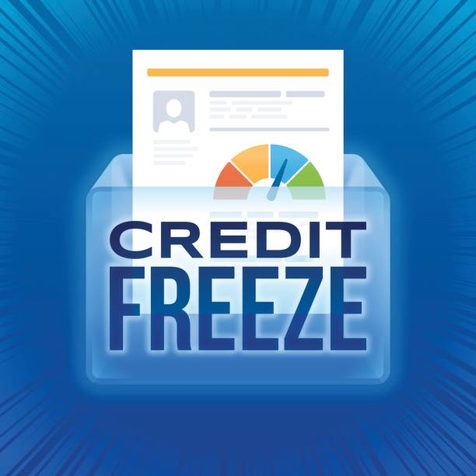
Building A Better Credit Report
What is a credit freeze?
Does a credit freeze affect my credit score?
How do I place a freeze on my credit reports?
https://media.istockphoto.com/vectors/credit-freeze-vector-id848315698?k=6&m=848315698&s=612x612&w=0&h=14ulAhiR3kUhVCiP1xwmPWzqskElP2pOB_SBpMjrjjc=
Notes:
Read and Explain Slide
Ask participants, do you know what is a credit freeze?
Allow 2-3 participants to answer
What is a credit freeze?
Also know as security freeze, lets you restrict access to your credit report
To place a freeze contact the nationwide credit reporting companies: Equifax, Experian and TransUnion (fee varies)
Does a credit freeze affect my credit score?
No. A credit freeze does not affect your credit score.
How do I place a freeze on my credit report?
Contact each of the nationwide credit bureaus
You'll need to supply your name, address, date of birth, Social Security number and other personal information.
After receiving your freeze request, each credit bureau will provide you with a unique PIN (personal identification number) or password. Keep the PIN or password in a safe place. You will need it if you choose to lift the freeze.
2.5 Minutes

Slide 23
Fraud Alert
What is a fraud alert?
There are 3 types of fraud alerts
What’s the difference between a credit freeze and a fraud alert?
Notes:
Read and Explain Slide
Ask participants, do you know what is a fraud alert?
Allow 2-3 participants answer
What is a fraud alert?
Allows creditors to get a copy of your report with the proper identity but prevent the misuse of your account from others.
There are 3 types of fraud alerts
Initial Fraud Alert –Prevent from being a victim of fraud
Extended Fraud Alert-Victim of fraud that protect for 7yrs
Active Duty Military Alert- Protect the member of military while being deployed for 1 year
Fraud alerts are free (must provide proof of identity)
What’s the difference between a credit freeze and a fraud alert?
A credit freeze locks down your credit. A fraud alert allows creditors to get a copy of your credit report
2-5 Minutes

Slide 24
Building A Better Credit Report
What are my options for dealing with debt?
Choosing a credit counseling organization
Non-profit credit counseling programs
Notes:
Read and Explain Slide
What are my options for dealing with debt?
Credit counseling
Debt consolidation
Bankruptcy
Choosing a credit counseling organization
Non-profit credit counseling programs
Credit unions
Universities
Military bases
U.S. Cooperative Extension Service branches
Nifa.usda.gov/extension
1 Minute

Slide 25
The Debt Snowball Effect
Step 1:
List your debts from smallest to largest regardless of interest rate.
Step 2:
Make minimum payments on all your debts except the smallest.
Step 3:
Pay as much as possible on your smallest debt.
Step 4:
Repeat until each debt is paid in full.
Notes:
Read and Explain Slide
Ask the participants, how many of them know about the Snowball effect?
Allow 2-3 participants to answer
2 Minutes

Slide 26
Debt Snowball Method Sample
Say you have four debts:
$500 medical bill—$50 payment
$2,500 credit card debt—$63 payment
$7,000 car loan—$135 payment
$10,000 student loan—$96 payment
Notes:
Read and Explain Slide
Using the debt snowball method
you would make minimum payments on everything except the medical bill. But let’s say you have an extra $500 each month because you took a side job and cut your expenses
down to the bare minimum.
Since you’re paying $550 a month on the medical bill (the $50 payment plus the extra $500), that debt will be gone in one month.
Then, you can take the freed-up $550 and attack the credit card debt, paying a total of $613 ($550 plus the $63 minimum payment).
In about four months, you’ll wave goodbye to that credit card. You’ve paid it off!
Now, punch that car loan in the face to the tune of $748 a month. In 10 months, it’ll drive off into the sunset. Now you’re on fire!
By the time you reach the student loan—which is your biggest debt—you can put $844 a month toward it.
2 Minutes

Slide 27
Got Bad credit?
Steer clear of credit repair scam
Notes:
Read and Explain Slide
Ads
WE CAN REMOVE BANKRUPTCIES, JUDMENTS, LIENS, AND BAD LOANS FROM YOUR CREDIT FILE FOREVER!
CREDIT PROBLEMS? NO PROBLEM!
WE CAN ERASE YOUR BAD CREDIT-100% GUARANTEED
CREATE A NEW CREDIT IDENTITY-LEGALLY
1 Minute

Slide 28
When Requesting Service…
Questions to Ask
Notes:
Read and Explain Slide
Questions to ask
What services do you offer?
Do you offer information or materials?
What are your fees?
What if you can afford to pay all at once?
Is there a written agreement or contract
Are you license to operate?
What do you have in place for privacy?

Slide 29
Your Responsibilities:
Borrow only what you can repay
Read and understand the credit contract
Pay debts promptly
Notify creditor if you cannot meet payments
Report lost or stolen credit cards
Never give your card number over the phone unless you initiated the call or are certain of the caller’s identity
Notes:
Read and Explain Slide
Your Responsibilities

Slide 30
Your Rights:
1968 Truth in Lending Act
1970 Fair Credit Reporting Act
1974 Equal Opportunity Act
1974 Fair Credit Billing Act
1977 Fair Debt Collection Practices Act
Notes:
Read and Explain Slide
Ask the participants, how many of them are familiar with any of the above Acts?
Allow 2-3 participants to answer
Truth in Lending Act (1968) Ensures consumers are fully informed about cost and conditions of borrowing.
Fair Credit Reporting Act (1970) = Protects the privacy and accuracy of information in a credit check.
Equal Opportunity Act (1974) = Prohibits discrimination in giving credit on the basis of sex, race, color, religion, national origin, marital status, age, or receipt of public
assistance.
Fair Credit Billing Act (1974) = Sets up a procedure for the quick correction of mistakes that appear on consumer credit accounts.
Fair Debt Collection Practices Act (1977) = Prevents abuse by professional debt collectors, and applies to anyone employed to collect debts owed to others does not apply to banks or other businesses collecting their own accounts.
2 Minutes

Slide 31
Dispute Letter
Date
Your Name
Your Address, City, State, Zip Code
Complaint Department
Name of Company
Address
City, State, Zip Code
Dear Sir or Madam:
I recently obtained a copy of my credit report from your agency and found the following item to be in error: Item 1: I dispute ABC credit card account number 555111. This account has been paid in full. I am requesting that the item be (removed, updated, or other suggested change) to correct the information. Enclosed are copies of (use this statement if you have bank statements, cancelled checks, or other documentation) supporting my position. Please reinvestigate this (these) matter(s) and (delete or correct) the disputed item(s) as soon as possible.
Sincerely,
Your name
Enclosures: (List the documents you are enclosing. If none, do not include this section).
Notes:
Read and Explain Slide
Sample Dispute Letter
1 Minute

Slide 32
Resources
Free Credit Reports
Building a Better Credit Report
Choosing a Credit Counselor
Credit Scores
Disputing Errors on Credit Reports
Fixing Your Credit
Federal Trade Commission/consumer.ftc.gov
Notes:
Read Slide
Resources

Slide 33
Questions?

Slide 34
Contact
Carolyn L. Banks
Agricultural Business Management Specialist
1000 ASU Drive #479
Lorman, MS 39096
601-877-6260
cbanks@alcorn.edu
Notes:
Read the slide

Slide 35
Thank You!

