Slide 1
Farm Inventory

Slide 2
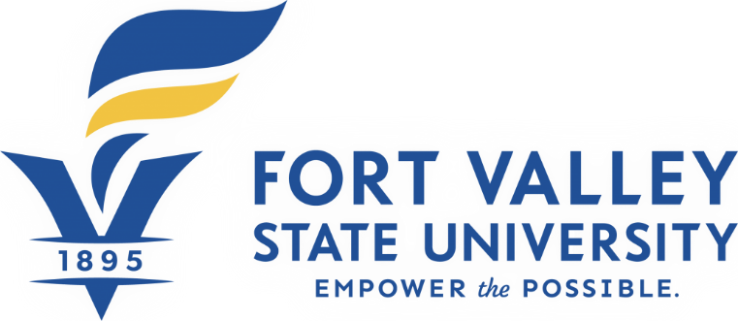
In Partnership with:

Slide 3
What would you do if a fire, flood, tornado, or other covered disaster strikes your farm or ranch, will you be able to make a list of all the damaged or destroyed equipment for your insurer?
Notes:
Read and Ask the participants the question.
Allow 2-3 participants to answer
Ask do they keep records, if so, where are the records located
5 minutes

Slide 4
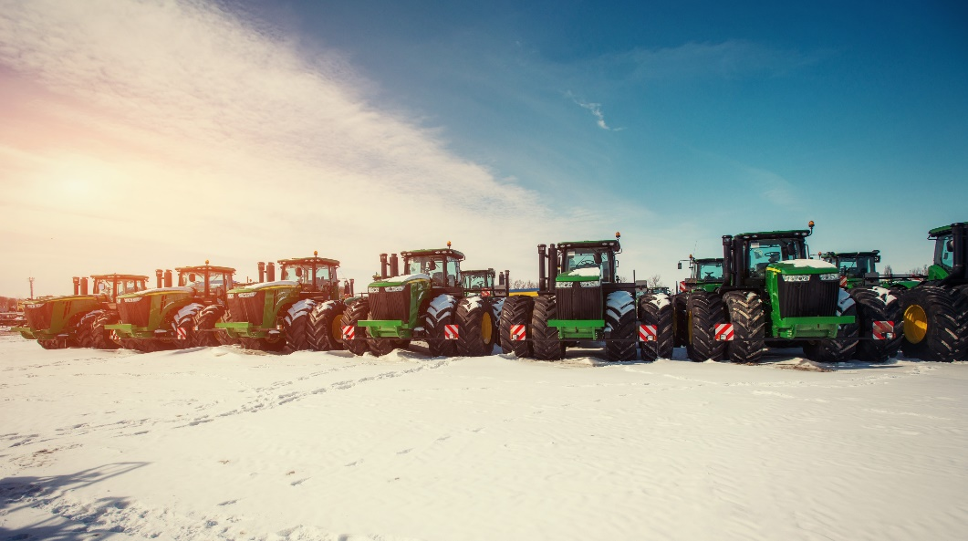
What is Farm Inventory?
A farm inventory is a list of assets - anything of value - that can be sold.
The inventory list can include the price of the item, the value of the stock, the year it was bought, the expected lifetime, and the depreciation in value.
Notes:
Read the slide
Ask the participants, how many of them keep an inventory?
Allow 2-3 participants to answer
Ask the participants, what is included in their inventory?
5 minutes

Slide 5
Purpose of Farm Inventory
The purpose of inventory is to monitor the stocks movements as basis for daily stocks position and levels for procurement purposes. Also it helps management on decision-making when it comes to what is fast moving, slow moving, and non-moving stocks.
Notes:
Read the slide
Ask the participants, do you think keeping an inventory is necessary?
Allow 2-3 participants to answer, why or why not
5 minutes

Slide 6
Reasons Why A Farmer Records are Important
Help a farmer to keep stock and manage each aspect of the farm properly.
Important for planning and budgeting.
Provide a farmer with enough information needed for proper planning and budgeting at every point in time.
Notes:
Read the slide
Ask the participants, do you keep records and why or why not
Ask the participants how are your records stored (mentally, manually (shoe box) , computer)
Allow 2-3 participants to answer
5 minutes

Slide 7
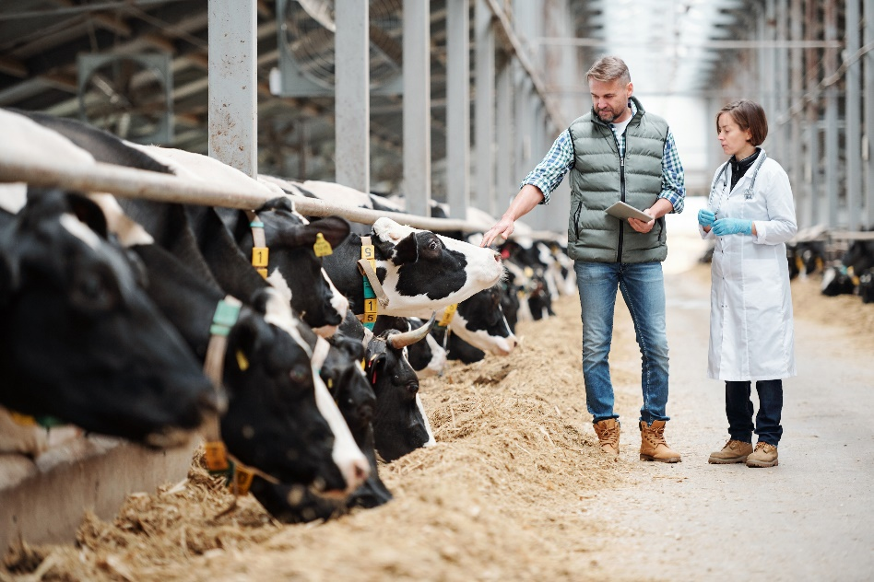
Creating A Farm Inventory
At least once a year
Include everything in the farm by categories
Land
Animals
Equipment
Supplies
Machinery
Stock
Buildings
Notes:
Read the slide and explain
Farm Inventory Farmers should keep records that show the actual count or measurement of their inventory.
Products held for sale. All harvested and purchased farm products held for sale or for feed or seed, such as grain, hay, silage, concentrates, cotton, tobacco, etc.
Supplies. Supplies acquired for sale or that become a physical part of items held for sale. Deduct the cost of supplies in the year used or consumed in operations.
Livestock. Livestock held primarily for sale.
Growing crops. Generally, growing crops are not required to be included in inventory. However, if the crop has a pre-productive period of more than two years, the farmer may have to capitalize under the uniform capitalization rules (or include in inventory) costs associated with the crop.
2 minutes

Slide 8
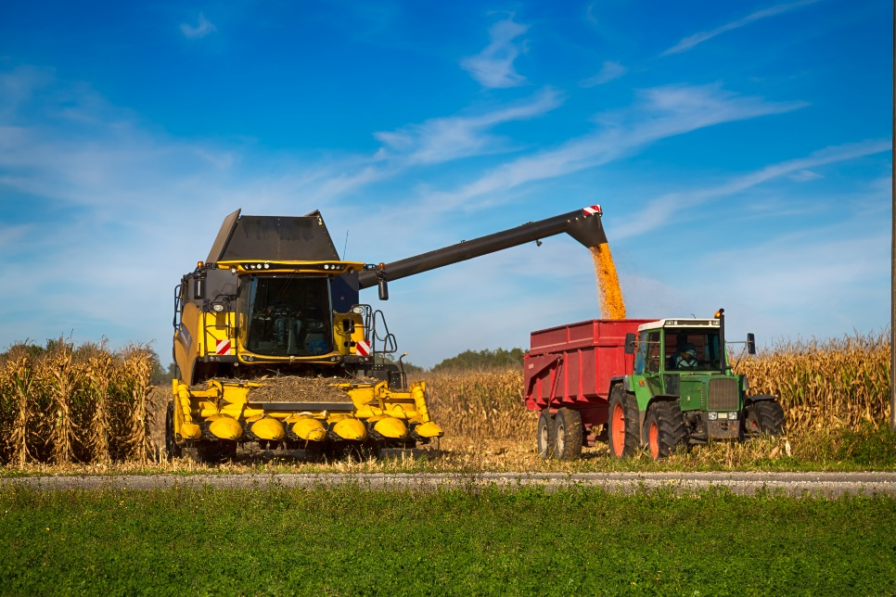
Examples of equipment to inventory
Tractors, trucks, ATVs
Combines, corn pickers
Backhoes, hay balers, wagons
Disks, cultivators
Seeders and planters
Fertilizer spreaders, sprayers
Milking machines, air compressors
Pumps, irrigation equipment
Post hole diggers, manure spreaders
Mowers, snow throwers, motors
Notes:
Read the slide and explain
Consider marking each piece with a permanent identification number. If your equipment is stolen, an ID number will be useful for law enforcement. Use a metal engraver or stamping tool, and place the number in an inconspicuous spot.
1 minute

Slide 9
Mississippi Farm Record Book Farm Inventory
Notes:
Read the slide and explain
Insert from the Mississippi Farm Record Book/Inventory Page
3 minutes

Slide 10
Advantages of Inventory
Ensuring that the farm business does not spend money on unnecessary product orders
Tracking which products are selling and which are not
Determine if equipment may need to be repaired
Ensure that existing equipment is adequately covered when insurance policy renews
Add new equipment to insurance policy when it renews
Notes:
Read the slide
Ask participants, if there more they can add to the advantage of having an inventory?
Allow 2-3 participants to answer
2 minutes

Slide 11
Filing an Insurance Claim
Conduct an equipment inventory so you have a detailed record of each tool, including:
Purchase date and receipts
Estimated replacement value
Serial or ID number
Model number, brand, and year
Notes:
Read the slide
Ask the participants, do you have insurance on their farm and farm equipment, machinery, etc ?
Allow 2-3 participants to answer, why or why not
3 minutes
This information helps your insurance company reimburse you fairly and quickly, according to your policy provisions. Many farm management software packages include inventory tools that help make the job easier. But a notebook and a file box of organized receipts can also work.
Whatever you use, store your inventory records in a safe, off-site location, such as a safe deposit box. If your home is damaged, your records could be damaged, too.

Slide 12
Disadvantages of Farm Inventory
Time consuming
Small business with limited products may not need an inventory system
Notes:
Read the slide
Ask participants, if there more they can add to the disadvantage of having an inventory?
Allow 2-3 participants to answer
2 minutes

Slide 13
What are the Disadvantages of Holding Too Much Inventory?
Ties up the funds of the operation
Prohibits those funds from being used elsewhere in the farm operation
Notes:
Read Slide
A major disadvantage to holding too much inventory on hand is the negative cost implications. Purchasing any type of inventory or product ties up the funds of the company and prohibits those funds from being used elsewhere in the business.
Ask participants, if there more they can add to the disadvantage of having too much inventory?
Allow 2-3 participants to answer
2 minutes

Slide 14
Inventory Management VS Inventory Control
What is Inventory Management?
What is Inventory Control?
What are their Similarities?
What are the Differences between Inventory Management and Inventory Control?
Notes:
Read the Slide and Explain
Ask participants, who manages and control their farm inventory?
Allow 2-3 participants to answer
What is Inventory Management?
These are measures and activities aimed at the management and maintenance of inventory demand and replenish. This can be summed as ensuring the right quantity of inventory is available, inventory is paid on time, and also having an effective re-order point. While a large inventory carries theft, spoilage and damage risks, a low inventory may cause low output levels. While most companies keep track of inventory manually, large businesses may use software applications.
Activities carried out under inventory management include:
Keeping track of when to restock
Inventory to restock
Amounts to produce
When to sell
The price at which to sell at
What is Inventory Control?
Also referred to as stock control, this is the process of adopting and implementing practices aimed at regulating inventory between the period it is purchased and the period it is converted to a final product.
Inventory should be controlled in a manner such that there is not too much inventory at one time, which would result in an increase of the inventory cost, nor too little, which in return would affect the end product quantity and quality. It hence offers a balancing point between the finished goods and the optimum storage capacity. There should hence be a set reorder point for any inventory.
The common areas under which inventory control is important include:
Raw materials availability- This ensures that there are sufficient raw materials for production
Finished goods availability- This regulates pricing while also boosting customer satisfaction.
Work in progress- Inventory control helps in the reduction of inventory that is already in the production process. This can be done by job size minimization and inventory travel time reduction.
Reorder point- This is the set point at which inventory should be re-ordered. It should be set at an optimal point, which is not too low or too high.
Outsourcing- Inventory control is resourceful when it comes to outsourcing decisions, such as suppliers.
What are their Similarities ?
Both are essential in managing inventory in a business
Inventory management refers to measures and activities aimed at the management and maintenance of inventory demand and replenishment. On the other hand, inventory control is the process of adopting and implementing practices aimed at regulating inventory between the period it is purchased and the period it is converted to a final product.
Inventory management involves keeping track of when to restock, what to restock, amounts to produce, when to sell and the price at which to sell at, inventory control involves the regulation of inventory that is in a warehouse such as knowing what product and the number available, location in the warehouse and ensuring the products remain in good condition.
7 minutes

Slide 15
Notes:
Read the Slide and Explain

Slide 16
Resources
https://www.nationwide.com/lc/resources/farm-and-agribusiness/articles/farm-equipment-inventory
https://williamstaxandbookkeeping.com/files/2016/12/Farm-Inventory-and-Accounting-Methods.pdf
https://www.lsuagcenter.com/~/media/system/0/8/3/d/083d009ad4cc4c89d602b65a65e288e0/pub1849farminventorybook.pdf
http://www.differencebetween.net/business/difference-between-inventory-management-and-inventory-control/
Notes:
Read slide

Slide 17
Questions?
Notes:
Read the slide

Slide 18
Contact
Carolyn L. Banks
Agricultural Business Management Specialist
1000 ASU Drive #479
Lorman, MS 39096
601-877-6260
cbanks@alcorn.edu
Notes:
Read the slide

Slide 19
Thank You!

