Slide 1
AgGeorgia Overview, Eligibility, and Applying for a Loan Lee Lister Relationship Manager

Slide 2
AgGeorgia Fast Facts
Dedicated to providing sound, dependable funding for farmers, agribusinesses, and rural land and homeowners
Part of the Farm Credit system
The nation’s #1 and single largest agricultural lender
History of farm and agriculture lending for over 100 years
A customer-owned cooperative
4,700+ Borrowers are members who are part owners
Governed by elected Board of Directors (AgGeorgia borrowers)

Slide 3
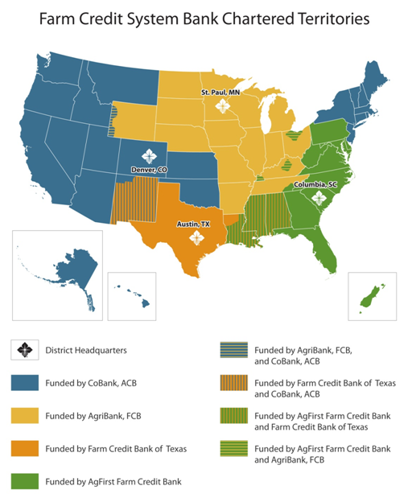

Slide 4
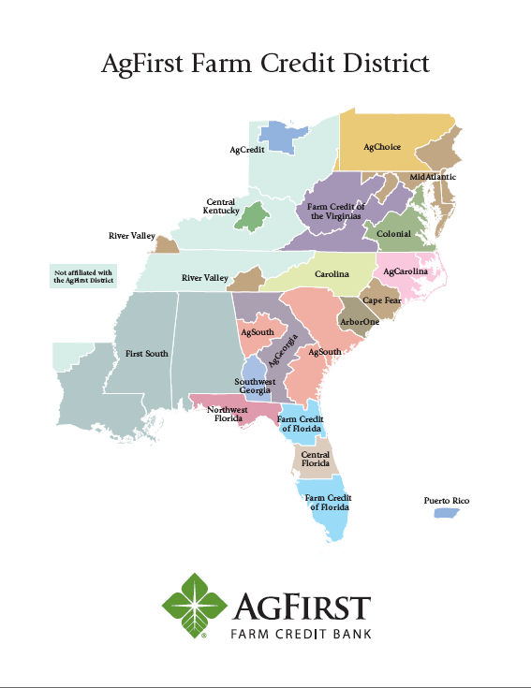
District Structure
AgFirst Farm Credit Bank serves 15 eastern states
19 Farm Credit associations own AgFirst FCB

Slide 5
AgGeorgia Farm Credit
20 locations
Serving 79 counties
in Georgia
Headquartered in Perry, GA

Slide 6
Loans for Land, Farms, and Homes
Specialize in agricultural lending
Understand the cycles of agriculture
Work with customers to meet their operation’s needs
Believe in the importance of farming & agribusiness
Specialize in financing for land and rural living
Value customers’ desire to own land
Believe in providing opportunities to grow rural communities

Slide 7
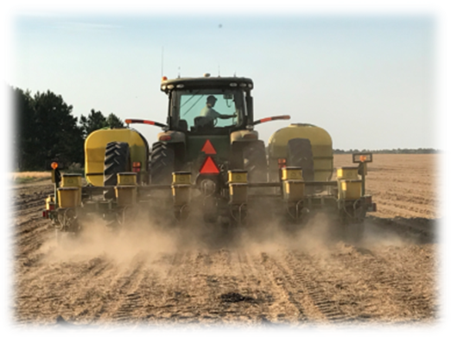
Farm Loans
Full-time & Part-time farmers
Land Purchases or Refinances
Operating lines of credit
Equipment –new and used
Livestock purchase
Improvements to Ag real estate
Fencing, wells, ponds, drainage, reforestation, irrigation, buildings, clearing, orchard or grove establishment

Slide 8
Land Loans
Types of Loans:
Purchase
Farmland, Timberland
Recreational property, lots
Refinance
Improvements
Buildings and specialized facilities
Drainage, irrigation, wells, ponds
Fencing
Reforestation
Recapitalization

Slide 9
Loan Products - Most Common Questions
What type of terms are available?
20-year terms or amortization on timberland / farmland
15-year terms on poultry houses and specialized facilities
5 to 7 years on most equipment; large tractors, combines, etc…could be longer on certain types
Operating lines – generally up to 1 year
Tailor repayment schedule to meet cash flow generated by property / borrower

Slide 10
AgGeorgia Overview
The Cooperative Advantage
Patronage Dividend – Over the last 5 years AgGeorgia has averaged a return of 26% of interest back to its customers. That’s like getting 26 cents back for every dollar of interest paid on your loan. AgGeorgia has delivered over $393 Million in cash to our customers since 1988.

Slide 11
2019 Distribution of Profits
In 2020, AgGeorgia returned to our borrowers 24% of the interest earned in 2019.
$13.95 Million
30% Cash - $4.18 Million
70% Allocated Surplus $9.76 Million

Slide 12
Distribution of Profits
Total amount CASH put in the members’ pockets in 2020 =
$15 Million
($4.1 cash portion of Patronage + $10.9 ’10 & ‘11 Surplus Revolvement)
2010/2011/2012 Surplus Revolvement totaled
$10.9 Million

Slide 13
Patronage Example
Loan amount $200,000
Annual interest rate 6.00%
Loan period in years 20
# payments per year 1
Interest accrued in year 1 $12,000
Total patronage returned $2,400
30% is paid in cash
70% is paid in surplus revolvement to be paid back later
Using an estimated patronage of 20%, the effect of the patronage distributions reduce the nominal rate to
4.8%
Notes:
Nominal Rate=rate not considering inflation or time value of money. Done to keep calculation simple.

Slide 14
Applying For Financing

Slide 15
Who makes loans?
Farm Credit
Traditional Banks
Individuals
Point of Sale Lenders
Government Agencies
Insurance Companies

Slide 16
How does a bank decide what interest rate to charge on a loan?
The cost of money to the lender
Required return for investors of the lender
Servicing cost on the loan
Risk premium
Competition

Slide 17
To apply, you will need:
Farm Plan
Balance Sheet
Last 3 years’ W2s or, if self-employed, last 3 years’ tax returns
Location / Type of all real estate owned
Liabilities
Collateral Description
Notes:
Income – Specialized operations like Poultry and Dairies may have settlement statements which can supplement tax returns.

Slide 18
Lender Tips for a Smooth Loan Process
Keep good records.
Reduce the risk to yourself and your lender whenever possible.
Have a reasonable plan ready for your lender to review.
Keep your lender informed.
When you get a loan, use it for the purpose intended.
Properly structure loan terms.

Slide 19
Loan Qualification What we look for
Credit Worthiness
5 C’s of Credit
Character
Conditions
Capital
Collateral
Capacity

Slide 20
Character
Who is the borrower?
Reputation, Experience
Managements Ability
Farm, Financial, Production, Marketing
Past History
Farm Credit History, Credit Scores, CBI

Slide 21
Conditions
Environment in which loan is being made…
Industry / Commodity
Markets
Operation
Structure of the loan request itself
Notes:
Rate, terms, frequency of payments

Slide 22
Capital
Learn from Balance Sheet
Liquidity (ability to pay bills)
Equity (ownership % in assets)
Trends (growing equity)
Compare to peers in industry

Slide 23
Collateral
Should not be most important concern!
Insurance in case we guess wrong
Value is always uncertain.
Specialty operations are hard to value

Slide 24
Capacity!!!
By far, the most important factor!
Can they repay on time?
Primary Source
Secondary Source
“Do what is best for the Customer.”
May not always be what they want

Slide 25
AgGeorgia YBS Farmer Program
YBS = Young, Beginning, Small Farmer
Young borrower – age 35 or younger
Beginning borrower – 10 years or less farming or ranching experience
Small borrower – normally generates less than $250,000 in annual gross sales of agricultural or aquatic products

Slide 26
AgGeorgia Y,B,S Farmer Programs
Beginning Farmer/Socially Disadvantaged Down Payment Program
Farm Ownership Participation Loan Program
FSA Loan Guarantees
Quick Credit Program
Farm Credit Express

Slide 27
Beginning Farmer/Socially Disadvantaged Down Payment Program
Program can provide up to 95% funding for farm real estate purchases up to max of $667,000
Borrower puts down minimum 5% cash down payment
AgGeorgia finances 50% of purchase on a 30 yr amortization/20 yr balloon fixed rate at current rates
FSA finances 45% of purchase on 20 year fixed rate (currently 1.5%)
No Guarantee Fees!

Slide 28
Beginning Farmer/Socially Disadvantaged Down Payment Program (cont’d)
Eligibility
• Has participated in the business operation of a farm for at least three (3) years but has not operated a farm for more than ten (10) years.
• Will materially and substantially participate in the operation of the farm or ranch.
• Does not already own farm or ranch property totaling more than thirty (30) percent of the median farm size in the county where the farm or ranch is located.

Slide 29
Farm Ownership Participation Loan Program
Joint financing from AgGeorgia and FSA
FSA loans up to $300,000 at fixed rate up to 40 years (currently at 2.5%)
No limit on AgGeorgia financing (market rate), provide up to 20 yr fixed rate
AgGeorgia portion may be guaranteed by FSA for a fee paid by borrower
Not limited to Beginning, New, or Socially Disadvantaged Farmers

Slide 30
FSA Loan Guarantees
FSA can “guarantee” up to 90% of loans made by AgGeorgia, for a fee paid by borrower
Limit is currently $1,750,000 for both operating lines and farm ownership
Fee is 1.5% of the guaranteed portion of the loan
Guarantees help AgGeorgia to be able to make loans to borrowers that may not have sufficient collateral, equity, etc to obtain a conventional loan

Slide 31
Quick Credit Program
Scorecard program for quick decisions and closings based off Credit Score
Up to $250,000 loan amount
1-20 years
Monthly pay encouraged
Variety of purposes are eligible
Real Estate
Equipment
Farm Improvements

Slide 32
Farm Credit Express
Point of sale financing at participating equipment dealers
Up to $250,000, same format as Quick Credit Program
Loans over $250k eligible, but require conventional analysis
Generally 1-5 years for rolling equipment, up to 10 years for irrigation equipment

Slide 33
THANK YOU!
For what you do every day to grow the food and fiber that feeds and clothes our nation

