Slide 1
Leasing Benefits for Customers
of AgGeorgia Farm Credit
December 9th, 2020

Slide 2
Farm Credit Leasing Overview
Farm Credit Leasing is a wholly owned subsidiary of CoBank, part of the Farm Credit System.
Over $3.6 billion lease portfolio at March 1, 2020
Over $5.1 billion lease assets under management at March 1, 2020
Headquartered in Minneapolis, MN; regional offices and banking centers throughout the country (Including Columbia, SC – My Office)
Over 17,000 customers nationwide.
Works with 57 Farm Credit Associations nationwide.

Slide 3
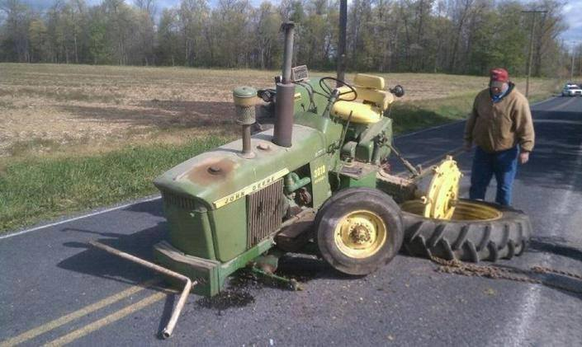
What Benefits Does a Lease Provide?
100% Financing:
  You spent all the cash to buy the land, now what?
Tax Advantages:
  You save money by writing off a higher expense than a traditional loan product over time
Cheap Money:
  Rates can range from 2% up to 5% depending on credit worthiness
  Save your cash now to invest in other capital investments
Estate Planning
  Leasing can effectively help transition ownership of a facility to the
  next generation at the end of the lease
Protection against obsolesce:
  See picture >

Slide 4
What You Need To Know
Very little we cannot lease (floats, flies or farts)
What is your tax and cash flow position
What and where is the asset
We don’t want the asset back
Getting going on a lease replacement program is easy

Slide 5
What if I am not a full-time farmer?
Part-Time Farmer: A Farmer that does not meet the definition of Full-Time Farmer but generates or intends to generate annual gross income on a sustained basis of at least $500 from Farming or owns at least five acres of Agricultural Land. There shall be no restriction to providing lease financing to Part-Time Farmers except as set forth in the FCA Regulations.
No limit on leasing of ag-related assets for these lessees
For full-time farmers, lease financing may generally be provided for any Non-Ag needs (still commercial)
For part-time farmers, certain sub-limits apply depending on the applicant’s Ag Assets:
  Ag Assets: A Farmer’s family assets and income-generating assets that are devoted primarily to Farming, including a rural homestead.
  The outstanding net investment in leased assets for Non-Ag Needs that are used primarily
    In Non-Rural Areas shall not exceed the value of the Part-Time Farmer’s Ag Assets.
    In Rural Areas shall not exceed twice the value of the Part-Time Farmer’s Ag Assets
    That contribute to the Part-Time Farmer’s ability to remain in Farming or transition more into Farming shall not exceed four times the value of the Part-Time Farmer’s Ag Assets, provided, however, that if the net investment in all leased assets to such Part-Time Farmer is to exceed $5 million, the net investment in leased assets for Non-Ag Needs shall not exceed the value of the Farmer’s Ag Assets.

Slide 6
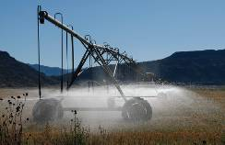
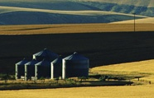
What We Lease
Irrigation Equipment | 2%
Communications, Technology
& Other Equipment | 6%
Automobiles, Trucks
& Trailers | 15%
Agricultural Equipment & Structures | 63%
Manufacturing & Materials Handling | 14%
Total
$5.1 billion
As of March 1, 2020

Slide 7
What is a lease?
A lease is simply an agreement between an owner (lessor) and a customer (lessee) to pay for use of the equipment in the form of rental payments for a specific amount of time with an option to return the equipment at the end. The customer is responsible for insurance, maintenance, and all other costs of ownership.
Notes:
These basic rules come through in various forms in the tax and accounting rules too.
LESSOR: owns equipment and charges for its use
LESSEE: pays for the use of the equipment

Slide 8
Lease Types and End of Lease Options
True Lease:
Customer deducts lease payments as operating expenses; lessor takes depreciation as tax owner of the equipment
Fixed Purchase Option (FPO)
Option to purchase the equipment for specified percentage of original cost, renew, or return
Purchase-or-Renew Only (PRO)
Option to purchase for specified percentage of original cost or renew the lease at the end of term
Terminal Rental Adjustment Clause (TRAC)
Option to purchase, return, or renew. If returned, it will be sold at fair market value. If the proceeds are greater than the residual, the customer receives the gain. If proceeds are less than the residual, the customer is responsible for the loss. *Only available for titled equipment.*
Conditional Sale Lease:
Customer entitled to tax benefits such as depreciation as tax owner of the equipment
Dollar Out or Purchase Upon Termination ($1 or PUT)
Pay $1 or other amount specified upfront as a balloon payment at the end of the lease term
Notes:
Leasing is governed by IRS and accounting standards. It all comes down to ownership. We’re going to focus on the tax side today. There are two basic types of leases when looking from a tax perspective: True Leases and Conditional Sale Leases.
With a True Lease, the lessee can deduct their lease payments as operating expenses, reducing their taxable income. The lessor takes the depreciation as the tax owner of the equipment. With a true lease, the residual or purchase option is usually 15% or greater. The end of lease options are determined at the start of the lease. Depending on the needs of the lessee, there are different options available for the customer to choose. Our 3 most popular options with a true lease are:
Fixed Purchase Option (FPO)
Option to purchase the equipment for specified percentage of original cost, renew, or return
Purchase-or-Renew Only (PRO)
Option to purchase for specified percentage of original cost or renew the lease at the end of term
Terminal Rental Adjustment Clause (TRAC)
Option to purchase, return, or renew. If returned, it will be sold at fair market value. If the proceeds are over the residual, the customer receives the gain. If proceeds are under the residual, the customer is responsible for the loss. *Only available for titled equipment like cars, trucks, over-the-road vehicles…but sprayers are also included. The great part about a TRAC is that there are no usage limitations.
There is also a Conditional Sale Lease. In this case, the lessee is entitled to tax benefits like depreciation and Section 179 expenses as tax owner of the equipment. This is very similar to a loan. The purchase options in this case are either $1 buyout or a Purchase Upon Termination, where you can purchase the equipment for the dollar amount specified upfront.
Each of these options is agreed to upfront, including the purchase option amount. There aren’t any surprises. The FPO provides the most flexibility and is our most popular option. The vast majority of our leasing customers end up purchasing their equipment. Full ownership – legal, tax, and accounting – passes to the customer upon exercising their purchase option.
What type of lease is best? It depends! That’s why it’s very important to work closely with your leasing representative, CPA, and other decision makers to understand your business plan, tax strategy, capex plan, and financial position to develop a mix of financing options to best suit the needs of your operations.

Slide 9
FCL Part Time Farmer Eligibility Changes
FCL’s Part Time Farmer Definition Revised
  Allows for intention to generate income
  Reduces the minimum income level from $1000 to $500
  Allows option for acreage in lieu of income
  Aligns with PT Farmer definition of many ACAs (each develops own)
  Part-Time Farmer: A Farmer that does not meet the definition of Full-Time Farmer but generates or intends to generate annual gross income on a sustained basis of at least $500 from Farming or owns at least five acres of Agricultural Land. There shall be no restriction to providing lease financing to Part-Time Farmers except as set forth in the FCA Regulations.
No limit on leasing of ag-related assets for these lessees
May require Part Time Farmer Application Addendum
  Attests to
    Intended income when schedule F is not available
    and/or
    Minimum agricultural land acreage (5 acre rural lot not acceptable)
  Attests that assets leased will be for commercial use
  Credit will identify when needed (expect extra review for all PT Farmer apps)

Slide 10
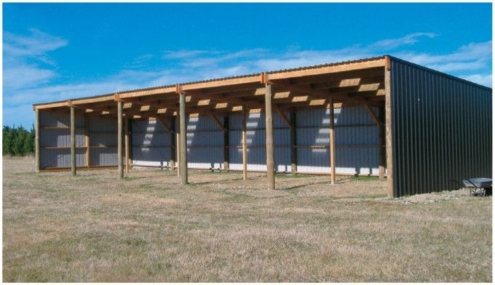
Success Story – Mr. White – PT Farmer
Owns 80 acres of timberland but has W-2 income as his primary income
Originally purchased the land with a loan from the ACA, has since paid off that loan
Wanted to build a $80K building on the land to park his equipment in and went back to the ACA for financing – The ACA partner knew a lease was the best product for the customer because:
  No appraisal needed
  No attorney fees
  No title search
  100% financing with construction funds available through an Interim Funding Agreement (IFA)

Slide 11
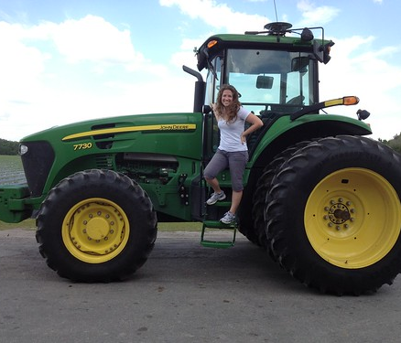
Success Story – Large Berry Farmer in Florida
  Total Transactions: $5,000,000 FCL Lease Line
  Repeat FCL customer with 24 contracts and growing
  Equipment: Tractors, Rolling Stock, Office Equipment, Potential Processing Equipment
  Structure:
  48 month $1 buyout on equipment for processing facility and tractors
  60 month 15% PRO on all rolling stock
  Customer Benefits: Low Upfront Costs, Interim Funding When Necessary, Accelerated Tax Write Off, Quick Turn Time on Funding Purchases (Typically Funds Out Door within 24 Hours of Signing on New Assets)

Slide 12
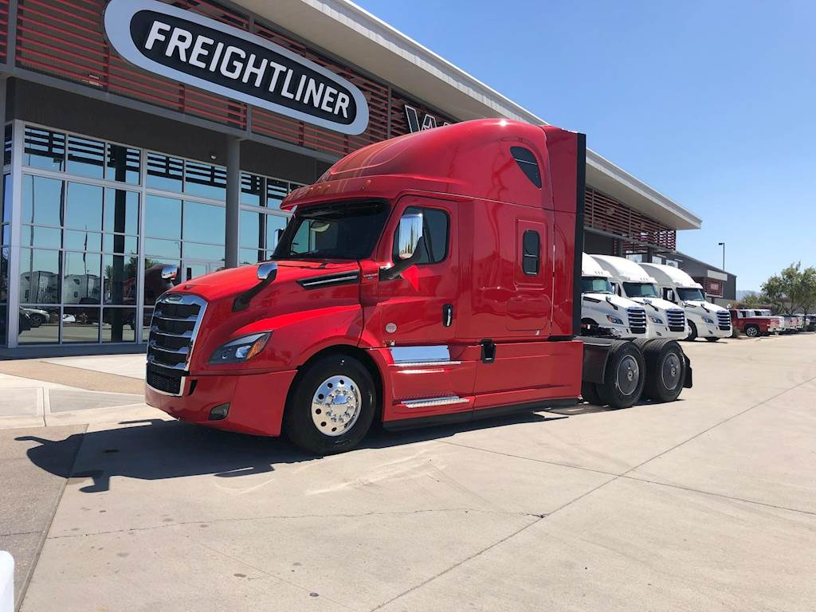
Success Story – Forest Product Hauler
Type of Customer
  Wood Products Hauler
Transaction
  $1,000,000
  FCL Leaseline was put into place shortly before the first transaction came through to provide quick approval
Structure
  60 months
  Monthly Payments
  $1 buyout
Benefits to Customer
  100% Financing
  Cheapest rate financed (much cheaper than the commercial banks!)

Slide 13
Commercial Facility Lease Program
Why are commercial facilities leased?
  Tax Advantages
    39 ½ year MACRS property
    Expense full lease payment vs. depreciation
  Capital Preservation
    100% financing
  Project/Construction Financing (IFA)
    FCL handles all payments to contractors
  FCL Knowledge and Expertise on facilities
  Estate Planning

Slide 14
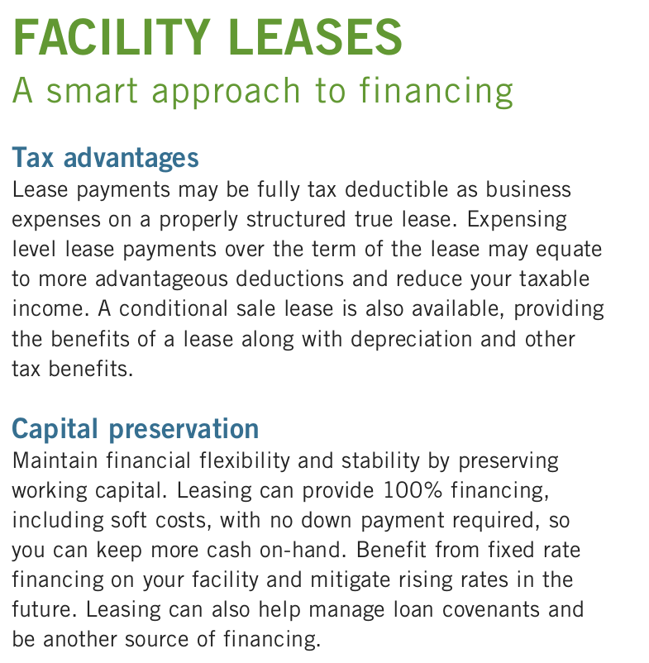
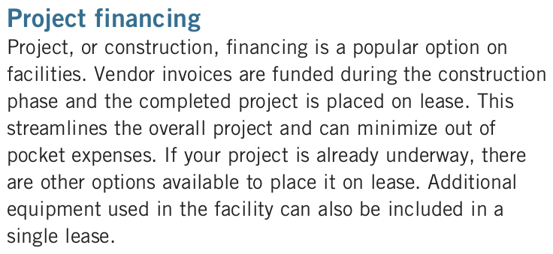
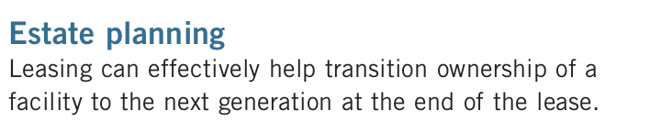
Building / Facility Program

Slide 15
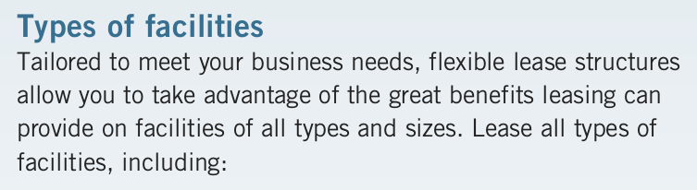
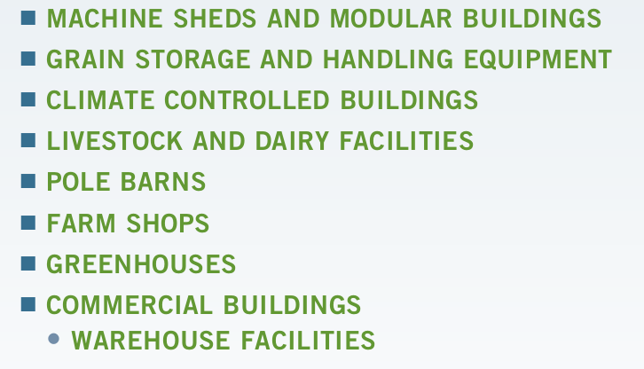
Buildings / Facilities – What types of Buildings can you lease?

Slide 16
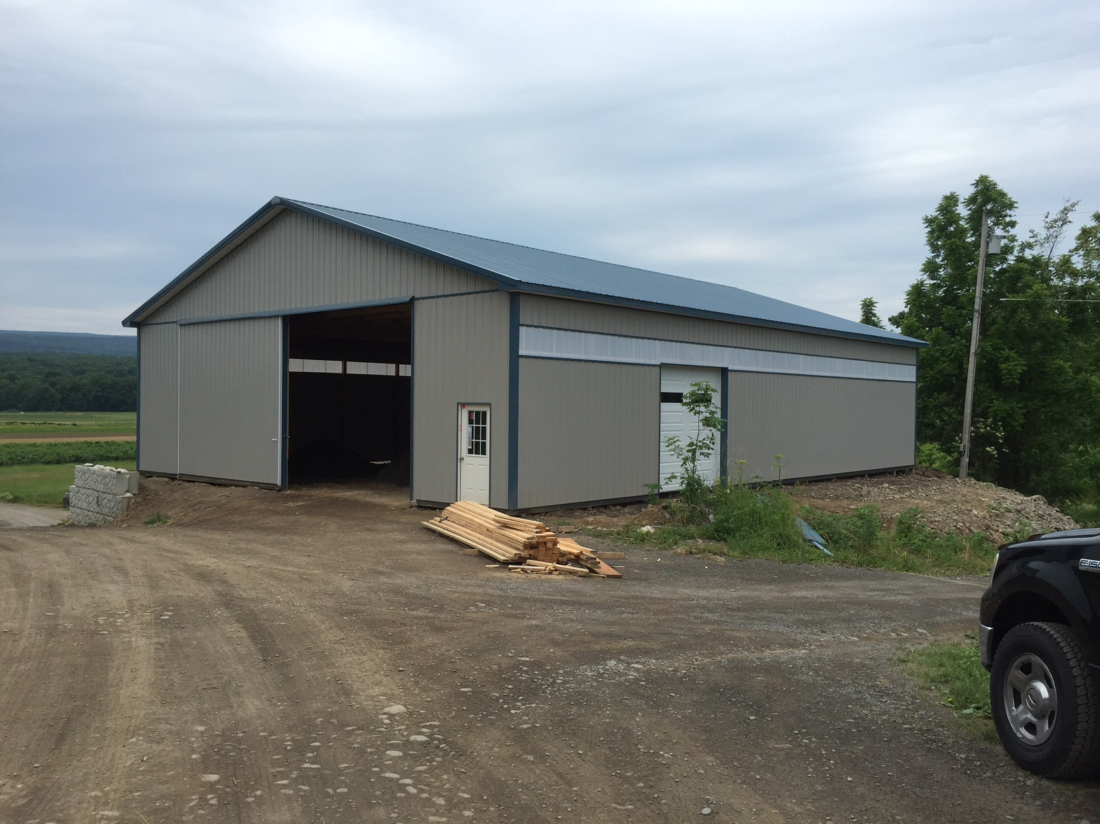
My Dream Farm in the Country, LLC
Classic ‘Wheel-house’ FCL building
$200,000 general purpose Ag
Full-time or Part-Time Farmer
Structure:
  84 months / 15% residual
  No Farm Credit Leasing mortgage
  Vs. 20 year MACRS
  Interim funding (construction note)
  1-day turn on docs
    Need legal land description

Slide 17

Facility Leases – Tax Advantages
How does leasing benefit my operation?
CALL MIKE to talk through options and which lease makes the most sense for my operation
Talk to your CPA and make sure they understand how to account for the benefits of the lease for your operation
See the benefits of how we can save you TAX DOLLARS!!

Slide 18
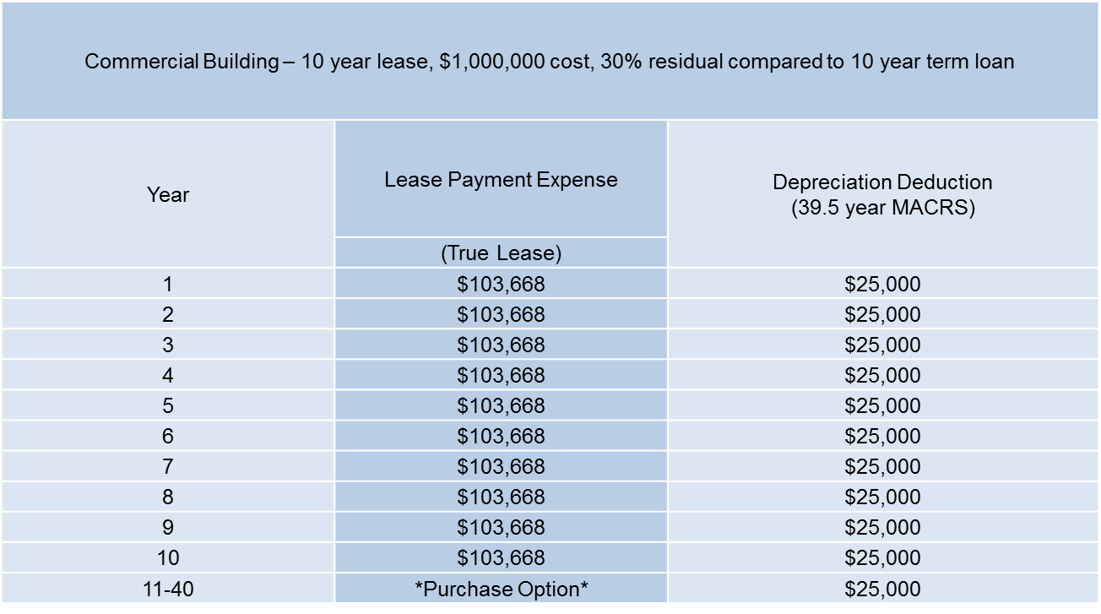
Facility Leases – Tax Advantages

Slide 19
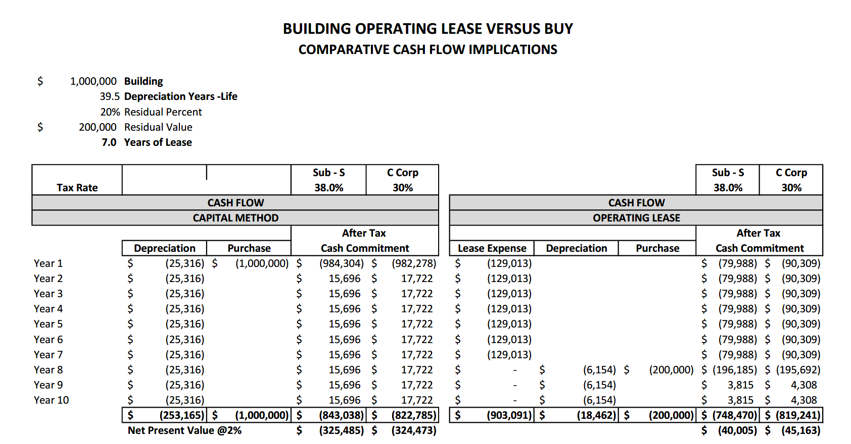
Facility Lease – Tax Advantages Continued

Slide 20
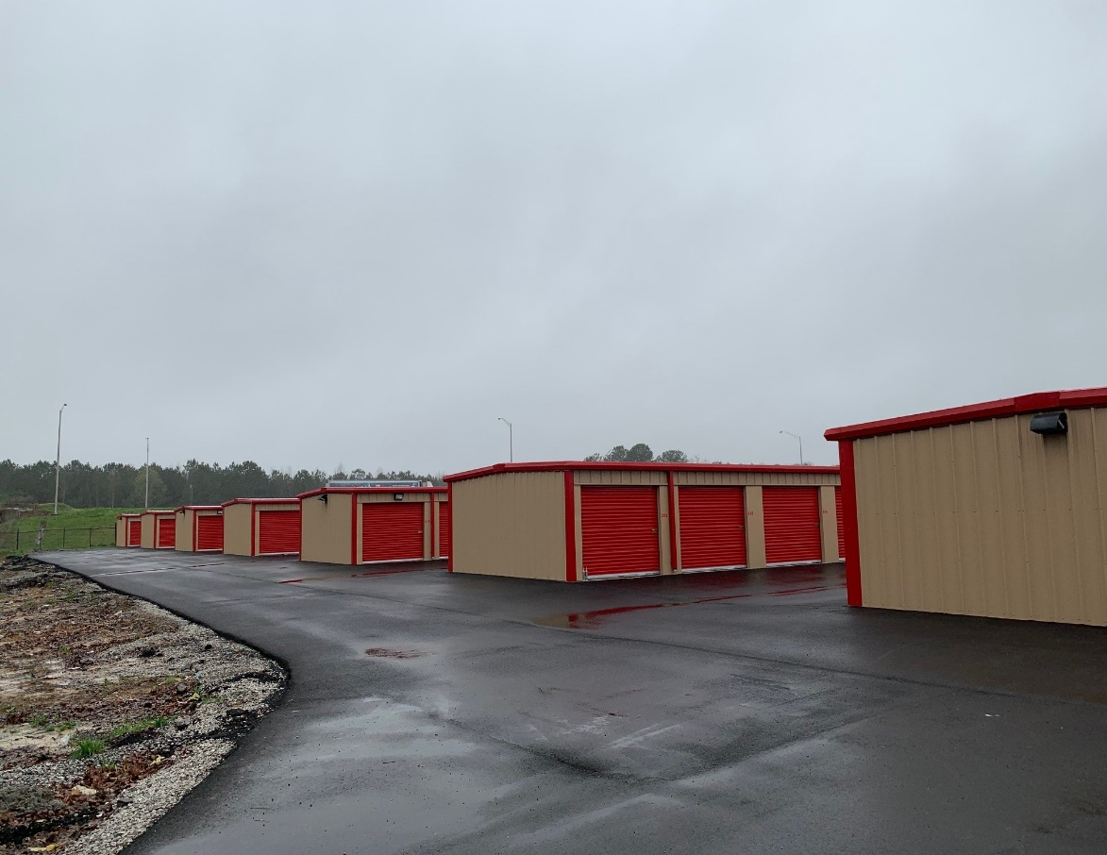
Success Story - Self Storage Facility
Type of Customer:
  Full-time Farmer
Structure:
  $966,000
  10 years
  monthly payments
  30% residual
Benefits to customer:
  Accelerated expense of the building by over a 10 year period;
  FCL 1st mortgage, 75% LTV
FCMA Office

Slide 21
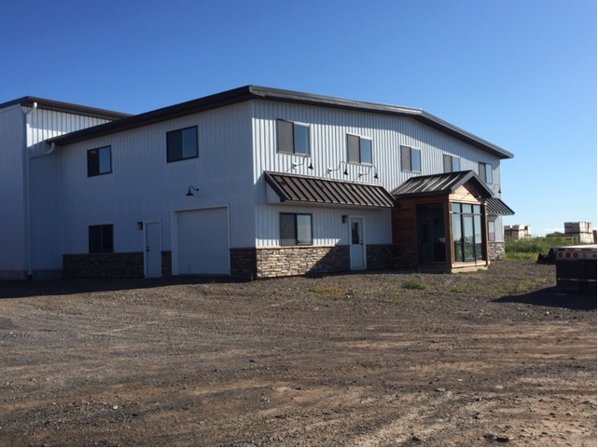
Success Story -Fruit Farm Customer
Type of Customer:
  Fruit production and processing operation
Structure:
  $ 497,000 on-farm Commercial office building
  84 Months – 20% residual
  PLB (Purchase Leaseback)
Benefits to customer:
  Accelerated expense of the 39.5 yr MACRS building over a 7 year period
  No mortgage
  No site inspections
  Customer was able to pay for some soft costs directly; FCL leased primary structure.

Slide 22
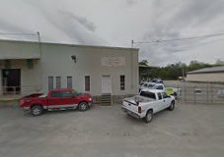
Success Story –Farm Center
Type of Customer:
  Long-time ACA customer since 1995.
  Farm related business primarily involved in the sale and customer application of fertilizer and chemicals.
Structure:
  $1,500,000 Cotton Bale Warehouse.
  60 Months – 25% residual.
  IFA (Interim Funding Agreement).
Benefits to customer:
  Accelerated expense of the 20 yr MACRS building (writing off 75% in 5 years).
  Customer had cash to buy the building, but due to uncertainty in the world he decided to keep his cash and finance.
  Customer was able to pay for some soft costs directly; FCL leased primary structure.

Slide 23

Succes Story – Winery and Vineyards
Type of Customer
  Family Owned Vineyard and Winery
  Wines are produced from local fruits grown on farm as well as from other local farms
Transaction
  $425,000
  Interim Funding Agreement – Started construction of new Wine Processing Facility to be completed in August, 2020
Structure
  120 month term with Monthly Payments
  15% residual
Benefits to Customer
  100% Financing
  Accelerated write-off the building (writing off 85% of the asset in ten years)
  Conserves working capital during this important growth period for the Company

Slide 24
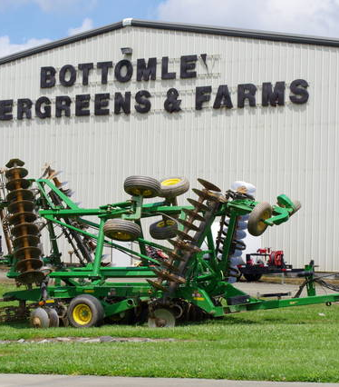
Success Story – Largest X-Mas Tree Grower in US
Type of Customer
  Repeat customer with this being their 9th lease
  Christmas Tree Grower
  Fresh Produce Farm
  Beef Cattle
Transaction
  $1,200,000
  Interim Funding Agreement - $1.2MM addition to an existing building under lease with FCL
Structure
  57 months – match remaining term of existing lease
  Monthly Payments
  15% residual
Benefits to Customer
  100% Financing
  Accelerated write-off the building (writing off 85% of the asset in less than five years)

Slide 25
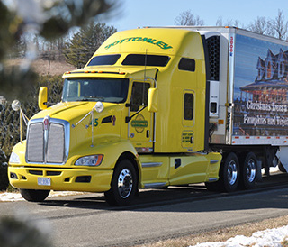
Success Story – Large Trucking Operation
Type of Customer
  Repeat customer of FCL
  Trucking Services Nationwide
  Ships agriculture products all over US
  95% Refrigerated Hauling
Transaction
  $13,795,000
  $12,000,000 leaseline established
Structure
  36 months
  Monthly Payments
  Match Residual to guaranteed buyback from dealership
Benefits to Customer
  100% Financing
  Accelerated write-off the building (writing off 85% of the asset in less than five year

Slide 26

FleetPartner is Farm Credit Leasing’s Fleet Management Services division
Major role is providing acquisition services to our members
Relationships with most auto manufacturers including Ford, Chevy, Ram, and Toyota
Allows Lessee to leverage FCL’s vehicle purchase volumes for pricing well below MSRP on new passenger vehicles and pickups, through
  FleetPartners’ Buying Power,
  Understanding and utilizing various discount programs, and
  Vehicle direct ordering

Slide 27
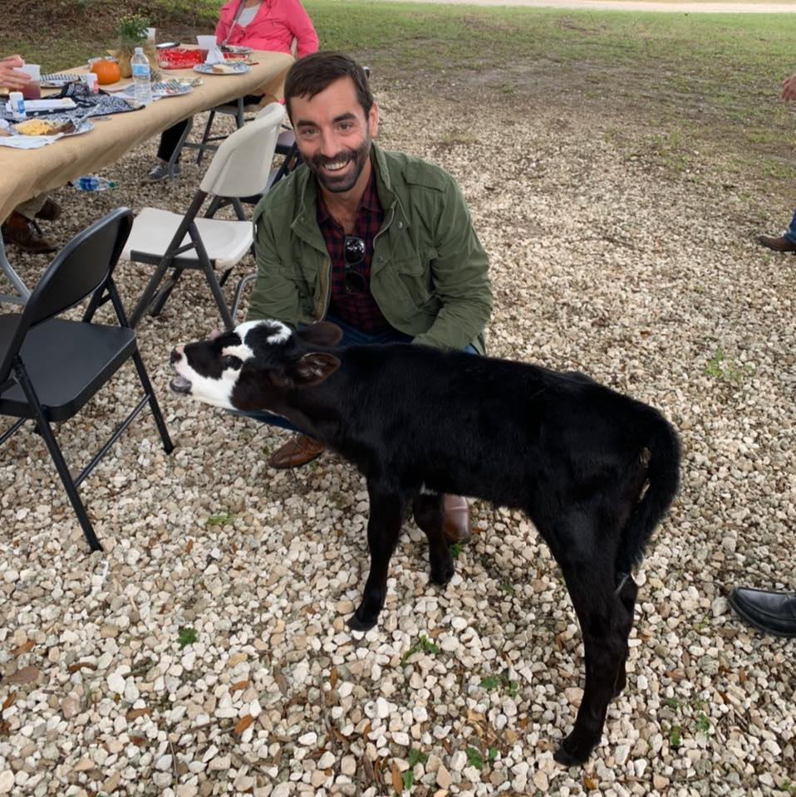
Thank You!!
Mike Anthos
615-337-9201
manthos@cobank.com

