Slide 1
Building a Sustainable Business: A Guide to Develop a Business Plan for Farms and Rural Businesses
Anthony R. McCarty, Extension Outreach Educator
ASUEP School of Agriculture and Applied Sciences
Notes:
Session Title: Building a Sustainable Business: A Guide to Develop a Business Plan for Farms and Rural Businesses
Before the Session:
Have this slide up when participants arrive.
Goal: Begin the process of building rapport among the group members.
The introductions can take too long if the group is large, but the participants may not know each other so taking time to facilitate introductions will be important. Feel free to use whatever process you prefer. Here are some suggested approaches to consider:
Ask individuals to introduce themselves to people around them in small groups, then have a spokesperson introduce everyone in the group simply providing name and organization.
Allow time for everyone to introduce him/herself to the full group (name & county).
Use smaller breakout rooms to allow the participants to network, introduce themselves to each other. (Break out session should last no more than 15 – 20 minutes.
Important note: If the group is very large, introductions need to be managed well to avoid too much time loss. Consider using a model like: Give your name, organization and one word that describes what you hope to gain in this training session. [Model the behavior so people will see that you want it short.]
Time: 10 Minutes

Slide 2
In Partnership with:
Notes:
Host or Trainer will acknowledge the sponsors who made this training possible.

Slide 3
Session Overview
The goal of this Business Plan Training is to provide participants with:
A general overview of the Farm Business Planning Process
A basic understanding of the Purpose of the Farm Business Plan
Notes:
Session Overview: Define the purpose of the session.
Provide a quick overview to the participants on this training session:
Key points to discuss:
General Overview of the Planning Process and
a basic understanding of the “Purpose” of the Farm Business Plan
Time: 1 minute
Materials: We will use “Building a Sustainable Business: A Guide to Developing a Business Plan for Farm and Rural
Businesses

Slide 4
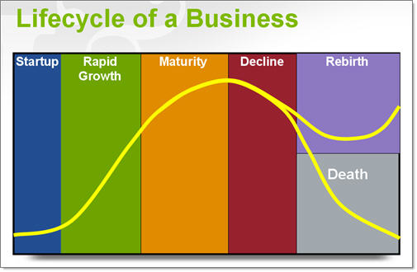
Business Life Cycle
This Photo by Unknown Author is licensed under CC BY-NC
Notes:
Start Up – In this stage the entrepreneur attempts to assemble sufficient assets to start a viable business. During this period the business is vulnerable to failure and income is light. The entrepreneur is often short of capital and know-how but possesses lots of enthusiasm.
Growth – During this period the business tends to expand rapidly in terms of acres of crops, head of livestock, or number of enterprises. The entrepreneur’s skills develop. However, lack of capital may limit growth during this period.
Maturity – During the maturity stage the manager has reached full employment and the size of the business stabilizes. This is often a period of good profits and excess capital. Also the entrepreneur often has highly developed management skills and concentrates on improving efficiency.
Decline – During this period the entrepreneur begins to wind-down the business. Rather than making new investments, the entrepreneur utilizes current machinery and facilities until retirement. Surplus capital often exists but labor may be in short supply. Non-Business Goals receives higher priority
Rebirth –Reinvest, expand, diversify, upgrade, reposition to take advantage of new marketing opportunities.
Death

Slide 5
Funding
PROGRAM | FY 2020 Available Funds | Funds Used as of 10/1/2020 | Total Unused Funds | No. of Loans Made
Direct Operating | $2,463,331,833 | $1,280,733,747 | $1,182,598,086 | 18,202
Non targeted funds | $1,005,471,763 | $420,228,208 | $585,243,555
Targeted funds | $1,457,860,070 | $860,505,539 | $597,354,531
Guaranteed Operating | $3,698,073,551 | $1,183,053,272 | $2,515,020,279 | 3,707
Non targeted funds | $2,022,776,348 | $787,406,371 | $1,2235,369,977
Targeted funds | $1,675,297,203 | $395,646,901 | $1,279,650,302
Direct Farm Ownership | $2,343,750,000 | $2,078,836,576 | $264,913,424 | 7,797
Non targeted funds | $556,702,500 | $546,004,862 | $10,687,638
Targeted funds | $1,787,047,500 | $1,532,831,714 | $254,215,786
Notes:
Before trainer began their presentation, give some background regarding available funding through USDA Farm Service Agency for small and beginning farmers.
Funding
This table shows loans made and funds used for various loan programs nationwide for Fiscal Year 2020. Targeted Funds refers to that portion of the annual allotment which is legislatively set aside for exclusive use by minority farmers, women farmers, and beginning farmers.
The key take away that I would like everyone to get from this chart is the fact that $597,354,531 was left on the table. The budget for next year will more than likely get cut when next years appropriations come out.

Slide 6
Funding Reports
https://www.fsa.usda.gov/programs-and-services/farm-loan-programs/program-data/index

Slide 7
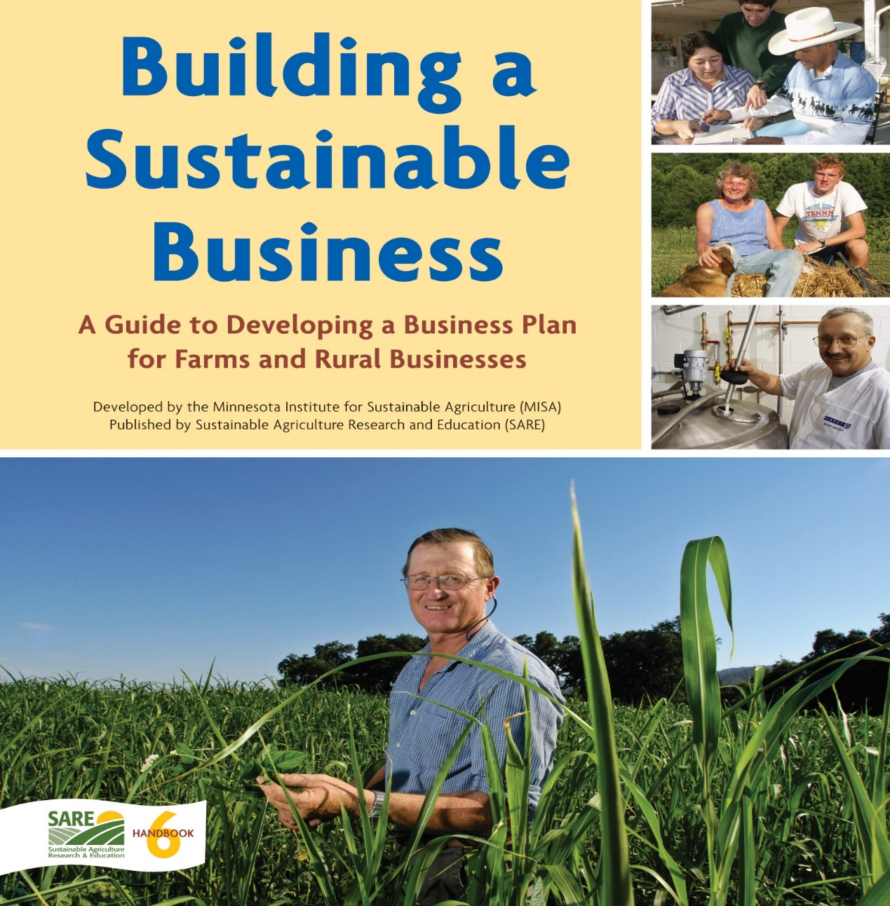
Building a Sustainable Business
Available free online at: https://www.misa.umn.edu/publications/ buildingasustainablebusiness
Notes:
Trainer will inform participate that the workbook used in this session was developed by the Minnesota Institute for Sustainable Agriculture:
Trainer will say to participants:
The information that we cover today comes from the manual “Building a Sustainable Business: A Guide to Developing a Business Plan for Farms and Rural Business”. This manual was conceived in 1996 by the Minnesota Institute for Sustainable Agriculture (MISA). This Guide was development over a period of seven years by a team of University of Minnesota faculty and staff, individual farmers and consultants. Ultimately this guide is as much about the planning process as it is about the creation of a final business plan. There was a 2010 reprinting of this guide and again in 2013 which is the version that we will be using.
Time: 3 min

Slide 8
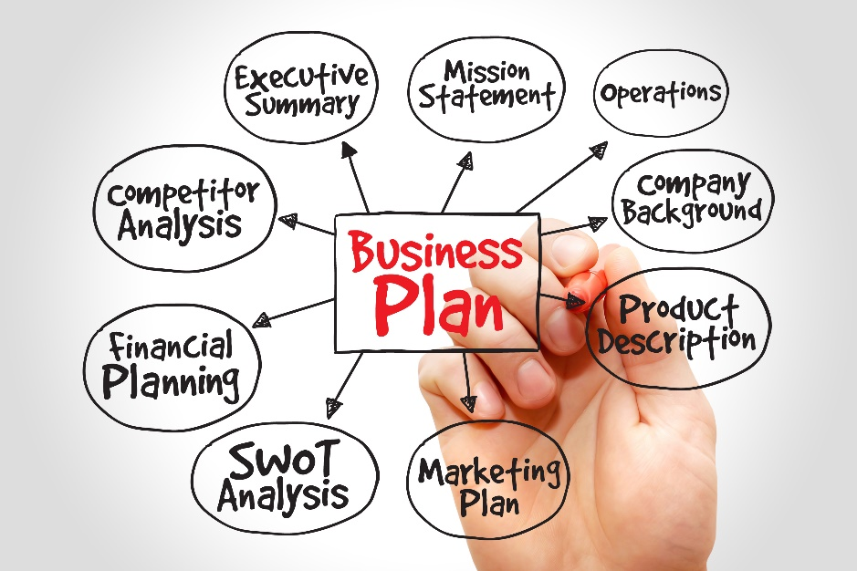
Why Do You Need a Business Plan?
The Purpose of Your Business Plan
Your business plan is very important. It is like a roadmap that shows how you will move form where you are now to where you want your operation to be in the future. A good business plan that describes your financial and operational goals will help you to evaluate your progress as you establish or continue your farm or ranch in the future. It shows that you have seriously though about your goals and plans for the future and that you understand all parts of your operation.
Notes:
On this slide the trainer will discuss why participants need a business plan:
It’s not just a document used to get operating capital
It’s a road map (GPS)
It describes your financial and operational goals
Helps you to evaluate your progress
Trainer will acknowledge the following:
The process can be a bit intimidating, however, it becomes more manageable when you divide the Business Plan Process into manageable tasks, called Planning Tasks.

Slide 9
Definition of Business Planning
Business planning is an on-going problem-solving process that can identify business challenges and opportunities that apply to your marketing, operations, human resources and finances, and develop strategic objectives to move your business beyond its current situation toward your future business vision.
Notes:
On this slide, The trainer will provide participants with a working definition of Business Planning:
Its an on-going problem-solving process
It identify business challenges as well as business opportunities.
Is designed to move your business beyond its current situation toward your future business vision
Trainer will state to participants:
So far, we’ve discussed the following:
1. Why you need a business plan and
2. We reviewed the definition of business planning
Now let’s discuss the five (5) Planning Tasks you will need to complete in order to develop your farm business plan.

Slide 10
5 Planning Tasks
Notes:
Here the trainer will introduce the 5 Planning Tasks:
Identify Values
Farm History and Current Situation
Vision, Mission, and Goals
Strategic Planning and Evaluation
Present Implement and Monitor your Business Plan

Slide 11
4 Key Functional Planning Areas
Notes:
Here the trainer will introduce the 4 Planning Areas:
1. Marketing
2. Operations
3. Human Resources
4. Finance

Slide 12
Planning Task One
Identify Values
What’s important to you?
What are values? (those things that you are most passionate about, thing that provide you with the greatest joy and satisfaction)
What values best identify your personal belief (Family, Faith, Finance, Status…Etc.)
An example of business model shape by personal values – Dan Cathy (Chairman and CEO) and the Cathy Family who owns Chic-Fil-A (Closed on Sunday)
Success at the expense of compromising your values is no success at all
Notes:
Trainer will read slide to participants and cover the following talking points:
What are values? (those things that you are most passionate about, thing that provide you with the greatest joy and satisfaction)
What values best identify your personal belief (Family, Faith, Finance, Status…Etc.)
Provide example of business model shape by personal values – Dan Cathy (Chairman and CEO) and the Cathy Family who owns Chic-Fil-A (Closed on Sunday)
Success at the expense of compromising your values is no success at all.

Slide 13
Planning Task One: Identify Values – What’s Important to You?
Discuss Values: What are they and how do they affect business planning and management decisions?
Identify your own values.
Identify common values among your planning team.
Prepare the Values section of your Business Plan.
Notes:
Trainer will read slide to participants and cover the following talking points:
Discuss Values: What are they and how do they affect business planning and management decisions?
Identify your own values
(Attempt to get audience participation)

Slide 14
Planning Task Two
Farm History and Current Situation
What have you got?
Know your farm history (Family). (Heritage, Legacy, Tradition)
Know your farm history (Business) – 3 years of production history, 3 years of Financial history, 3 years of Tax Returns
Know your current situation – financial ratios (income/expense, debt to asset, owner's equity) Current Balance Sheet, Current Income Statement, YEA, Farm Inventory
Current Projections (Crop loans approved, land leases signed, all farm equipment accounted for and field ready. Adequate feed and grazing for livestock)
Notes:
Trainer will read slide to participants and cover the following talking points:
Know your farm history (Family). (Heritage, Legacy, Tradition)
Know your farm history (Business) – 3 years of production history, 3 years of Financial history, 3 years of Tax Returns
Know your current situation – financial ratios (income/expense, debt to asset, owner's equity) Current Balance Sheet, Current Income Statement, YEA, Farm Inventory
Current Projections (Crop loans approved, land leases signed, all farm equipment accounted for and field ready. Adequate feed and grazing for livestock)

Slide 15
Planning Task Two: Farm History and Current Situation – What Have you got?
Prepare a brief history of your family, farm, and business
Assess your current situation:
Marketing:
Product
Customers
Unique Features
Distribution
Pricing
Promotion
Anticipated Marketing/Industry Changes
Operations:
Physical Resources
Production Systems
Management Systems
Human Resources:
Work Force
Unique Skills
Anticipated Changes in Work Force
Finances:
Needs
Performance
Risk
Financial Environment and Anticipated Changes
Conduct a whole farm SWOT analysis
Prepare the History and Current Situation section of your Business Plan
Notes:
Trainer will read slide to participants and cover the following talking points:
1. Get a note pad and start by jotting down basic information at first.
2. Add additional details later.
3. Attempt to address each of the planning areas
4. Not important to complete all in one session.

Slide 16
Planning Task Three
Vision, Mission & Goals
Where do you want to go?
Economist Thomas J. Law wrote; Money is a by-product of value. So, to thrive in the long run, businesses must remain focused on producing value. However, it’s easy to lose sight of value creation and get sidetracked by other things like profit margins, income and expense, risk and rewards, or competitors. To become a runaway success, businesses must have a purpose that unites and inspires people – “make more money” won’t do the trick.
As the author Simon Sinek said, “People don’t buy what you do, they buy why you do it.” And so, this is why businesses and organizations create mission and vision statements.
What comes first, Mission or Vision?
Notes:
Trainer will read slide to participants and cover the following talking points:
Economist Thomas J. Law wrote; Money is a by-product of value.
So, to thrive in the long run, businesses must remain focused on producing value.
However, it’s easy to lose sight of value creation and get sidetracked by other things like profit margins, income and expense, risk and rewards, or competitors.
To become a runaway success, businesses must have a purpose that unites and inspires people – “make more money” won’t do the trick.
As the author Simon Sinek said, “People don’t buy what you do, they buy why you do it.” And so, this is why businesses and organizations create mission and vision statements.
What comes first, Mission or Vision?
The first is a statement of vision. It provides a destination for the Farming operation. Next is a statement of mission

Slide 17
Planning Task Three
What is a Vision Statement?
1. What Is a Vision Statement?
A vision statement is sometimes thought of as a picture of your farming operation in the future, but it’s much more than that. When creating a vision statement, you're articulating your hopes and dreams for your Farm. Your vision statement is your inspiration, and it will serve as the framework for all your strategic planning.
What a Vision Statement Isn't
Don’t confuse a vision statement with a business plan for your future success. You can think of a vision statement as a rough road map, but a vision statement won't include specific milestones, revenue goals, or strategies for achieving those goals.
Your vision statement is your first step toward developing those goals and plotting your milestones. The vision statement is not tied to the details, and you shouldn't consider specifics while crafting it.
A vision statement should capture your passion for what you're trying to do, not your odds of actually achieving it.
Notes:
Trainer will read slide to participants and cover the following talking points:
1. What Is a Vision Statement?
A vision statement is sometimes thought of as a picture of your farming operation in the future, but it’s much more than that. When creating a vision statement, you're articulating your hopes and dreams for your Farm. Your vision statement is your inspiration, and it will serve as the framework for all your strategic planning.
What a Vision Statement Isn't
Don’t confuse a vision statement with a business plan for your future success. You can think of a vision statement as a rough road map, but a vision statement won't include specific milestones, revenue goals, or strategies for achieving those goals.
Your vision statement is your first step toward developing those goals and plotting your milestones. The vision statement is not tied to the details, and you shouldn't consider specifics while crafting it. A vision statement should capture your passion for what you're trying to do, not your odds of actually achieving it.

Slide 18
Planning Task Three
How a Vision Statement Works?
While a vision statement doesn't tell you how you're going to get there, it does set the direction for your business planning. That makes creating one especially important for small Farming operations. Poorly communicated vision is one of the main reasons small farms fail. Conversely, being able to craft and articulate a vision is one of the hallmarks of a strong farm business leader.
A Farm’s vision statement also provides a point of focus for marketing. Marketing campaigns and messages can be checked against the vision to ensure that the marketing is in line with the direction provided by the vision statement.
.
Notes:
Trainer will read slide to participants and cover the following talking points:
How a Vision Statement Works
While a vision statement doesn't tell you how you're going to get there, it does set the direction for your business planning. That makes creating one especially important for small Farming operations. Poorly communicated vision is one of the main reasons small farms fail. Conversely, being able to craft and articulate a vision is one of the hallmarks of a strong farm business leader.
A Farm’s vision statement also provides a point of focus for marketing. Marketing campaigns and messages can be checked against the vision to ensure that the marketing is in line with the direction provided by the vision statement.
Key Takeaways
A vision statement describes the long-term goals of the farm.
Vision statements are lofty and ambitious, and they don't contain details or steps for achieving those goals.
Vision statements are distinct from mission statements.

Slide 19
Planning Task Three
What is a Mission Statement?
According to Susan Ward wrote an article entitled “What is a Mission Statement” A mission statement is a brief description of the Farm’s purpose. It should answers the question, "Why does our business exist?" The mission statement articulates the Farm’s purpose both for those in the farming organization and for the public.
It's also important to avoid confusing a mission statement with a vision statement. The difference is that a mission statement focuses on a Farm’s present state while a vision statement focuses on a Farm’s future.
A mission statement answers the question "Who are You?" and the vision statement answers the question "Where are you going?"
Notes:
Trainer will read slide to participants and cover the following talking points:
According to Susan Ward wrote an article entitled “What is a Mission Statement” A mission statement is a brief description of the Farm’s purpose. It should answers the question, "Why does our business exist?" The mission statement articulates the Farm’s purpose both for those in the farming organization and for the public.
It's also important to avoid confusing a mission statement with a vision statement. The difference is that a mission statement focuses on a Farm’s present state while a vision statement focuses on a Farm’s future.
A mission statement answers the question "Who are You?" and the vision statement answers the question "Where are you going?"
According to Chris Bart, professor of strategy and governance at McMaster University, a commercial mission statement consists of three essential components:
Key market: the target audience.
Contribution: the product or service.
Distinction: what makes the product unique or why the audience should buy it over another.
Example -

Slide 20
Planning Task Three
Vision/ Mission Statement Summary?
Unlike the mission statement, a vision statement is primarily for you and the other members of your farm, not for your customers or clients. The purpose of the mission statement is to tell the world what you do and how you do it.
In other words, the vision statement is forward-looking, while the mission statement addresses the here and now. The vision statement is the dream; the mission statement is the reality.
Once you have both your vision statement and your mission statement, then you can start working on connecting those two concepts by creating an action plan. This is the detailed, step-by-step plan that that will help you make the vision you have for your Farm a reality.
Notes:
Trainer will read slide to participants and cover the following talking points:
Unlike the mission statement, a vision statement is primarily for you and the other members of your farm, not for your customers or clients. The purpose of the mission statement is to tell the world what you do and how you do it.
In other words, the vision statement is forward-looking, while the mission statement addresses the here and now. The vision statement is the dream; the mission statement is the reality.
Once you have both your vision statement and your mission statement, then you can start working on connecting those two concepts by creating an action plan. This is the detailed, step-by-step plan that that will help you make the vision you have for your Farm a reality.

Slide 21
Planning Task Three
Vision/ Mission Statement Examples
Tesla
Mission statement: To create the most compelling car company of the 21st century by driving the world’s transition to electric vehicles.
Vision statement: To accelerate the world’s transition to sustainable energy
Notes:
Trainer will read slide to participants.

Slide 22
Planning Task Three
Vision/ Mission Statement Examples
Nike
Mission statement: Create groundbreaking sports innovations, make our products sustainably, build a creative and diverse global team, and make a positive impact in communities where we live and work.
Vision statement: Bring inspiration and innovation to every athlete* in the world.
Notes:
Trainer will read slide to participants.

Slide 23
Planning Task Three
Vision/ Mission Statement Examples
Warby Parker
Mission statement: Warby Parker was founded with a rebellious spirit and a lofty objective: To offer designer eyewear at a revolutionary price, while leading the way for socially conscious businesses.
Vision statement: We believe that buying glasses should be easy and fun. It should leave you happy and good-looking, with money in your pocket. We also believe that everyone has the right to see.
Notes:
Trainer will read slide to participants.

Slide 24
Planning Task Three
Vision/ Mission Statement Examples
IKEA
Mission statement: Offer a wide range of well-designed, functional home furnishing products at prices so low that as many people as possible will be able to afford them.
Vision statement: To create a better everyday life for the many people.
Notes:
Trainer will read slide to participants.

Slide 25
Planning Task Three
Vision/ Mission Statement Examples
TED
Mission statement: Spread ideas.
Vision statement: We believe passionately in the power of ideas to change attitudes, lives and, ultimately, the world.
Notes:
Trainer will read slide to participants.
TED, which stands for “technology, education, and design,” managed to boil down their entire mission into two simple, yet powerful words: “Spread ideas.”

Slide 26
Planning Task Three
What is a Goal?
The object of a person's ambition or effort; an aim or desired result
Notes:
Trainer will read definition to participants.
The object of a person's ambition or effort; an aim or desired result

Slide 27
Planning Task Three SMART Goal
SMART is an acronym for specific, measurable, attainable, realistic, and timely.
Notes:
Trainer will read slide to participants and cover the following talking points:
In 1981, George T. Doran published a paper in Management Review that introduced SMART goals as a tool to improve the chances of reaching management goals. Clearly identifying what you want to achieve, during a specific budgeting period, will better enable you to achieve it. You can use the SMART tool for both short-term and-long term goals; the point is to make your goals clear and well defined.
Writing down clear goals makes them seem more tangible and provides a reference for decision making and monitoring success.
Here are some examples of budgeting goals you might consider for your farm:
Be more financially secure
Reduce debt load
Expand your farming operation
SMART is an acronym for specific, measurable, attainable, realistic, and timely. When you write down a goal, you’ll want to make sure that it meets all the criteria.

Slide 28
Planning Task Three
Specific
When defining a goal for your farm, be specific about what you want to accomplish. Think about the common “W” questions:
Who in your farming operation will be responsible for this goal? You may want to meet as a family or with key managers to open up the discussion and then decide on the person responsible.
By what amount do you want to reduce debt? Perhaps you want to target a specific loan to pay off.
Why are you setting this goal? For example, perhaps you have been focused on growth for several years and now it is time to shift resources to debt reduction, or maybe you want to reduce debt reduction to increase working capital.
Notes:
Trainer will read slide to participants and cover the following talking points:
Goals (Short-term, Intermediate and Long-term)
To illustrate, we’ll apply the SMART goals process to the goal of reducing debt load.
Specific
When defining a goal for your farm, be specific about what you want to accomplish. Think about the common “W” questions:
Who in your farming operation will be responsible for this goal? You may want to meet as a family or with key managers to open up the discussion and then decide on the person responsible.
By what amount do you want to reduce debt? Perhaps you want to target a specific loan to pay off.
Why are you setting this goal? For example, perhaps you have been focused on growth for several years and now it is time to shift resources to debt reduction, or maybe you want to reduce debt reduction to increase working capital.

Slide 29
Planning Task Three
Measurable
How are you going to assess whether you’re meeting the goal? It may take several months or even years to complete, so set milestones to ensure that you stay on track.
For example,
Pay off operating loan #1 in 6 months.
Forego purchasing new assets this year so all extra funds can be diverted to debt reduction.
Share monthly measures with your family or team to ensure your budget is in line with your actual financials.
Notes:
Trainer will read slide to participants and cover the following talking points:
Goals (Short-term, Intermediate and Long-term)
Measurable
How are you going to assess whether you’re meeting the goal? It may take several months or even years to complete, so set milestones to ensure that you stay on track.
For example,
Pay off operating loan #1 in 6 months.
Forego purchasing new assets this year so all extra funds can be diverted to debt reduction.
Share monthly measures with your family or team to ensure your budget is in line with your actual financials.

Slide 30
Planning Task Three
Achievable
What do you need to do to make this goal attainable? Will it require a change of attitude?
The purpose of articulating the goal is to motivate, so make sure it’s firmly grounded in reality. Use historical financial data as a benchmark to determine whether your goal is achievable within your budget.
Notes:
Trainer will read slide to participants and cover the following talking points:
Achievable
What do you need to do to make this goal attainable? Will it require a change of attitude?
The purpose of articulating the goal is to motivate, so make sure it’s firmly grounded in reality. Use historical financial data as a benchmark to determine whether your goal is achievable within your budget.

Slide 31
Planning Task Three
Relevant
Achievable goals are based on the current conditions and realities of the ag climate. You may desire to reduce debt, but if a recession is forthcoming or outside international forces have negatively impacted the grain market, then your goals aren’t relevant to the realities of the market.
Example: Opening up a bar during Covid-19
Notes:
Trainer will read slide to participants and cover the following talking points:
Relevant
Achievable goals are based on the current conditions and realities of the ag climate. You may desire to reduce debt, but if a recession is forthcoming or outside international forces have negatively impacted the grain market, then your goals aren’t relevant to the realities of the market.
Example: Opening up a bar during Covid-19

Slide 32
Planning Task Three
Timely
Anyone can set goals, but if they lack time frames, the chances of success are slim. Decide on a timeline for achieving your goal and set up time every month to monitor your position to make sure you are moving towards it.
Notes:
Trainer will read slide to participants and cover the following talking points:
Timely
Anyone can set goals, but if they lack time frames, the chances of success are slim. Decide on a timeline for achieving your goal and set up time every month to monitor your position to make sure you are moving towards it.

Slide 33
Planning Task Three
Goal Summary
SMART is an acronym for specific, measurable, attainable, realistic, and timely.
When writing your SMART goals for your farm, be prepared to ask yourself and other team members a lot of questions.
The answers will help you fine tune your approach. Analyze your successes and failures. By studying why a goal was or was not met, you can improve your chances for success next time.
Goals change over time, so periodically review them to see if they’re still appropriate and adapt them as circumstances change.
Written By
Becky Wedekind
Financial Analysist
Notes:
Trainer will read slide to participants and cover the following talking points:
SMART is an acronym for specific, measurable, attainable, realistic, and timely.
When writing your SMART goals for your farm, be prepared to ask yourself and other team members a lot of questions.
The answers will help you fine tune your approach. Analyze your successes and failures. By studying why a goal was or was not met, you can improve your chances for success next time.
Goals change over time, so periodically review them to see if they’re still appropriate and adapt them as circumstances change.
Written By
Becky Wedekind
Financial Analysist

Slide 34
Planning Task Four
Strategic Planning & Evaluation
What routes can you take to get where you want to go?
Notes:
Trainer will read slide to participants and cover the following talking points:
We talked about Value, History and Current Situation, Vision, Mission and Goals. Now with that information you are ready to begin developing a strategic plan.

Slide 35
Planning Task Four: Strategic Planning and Evaluation- What Routes Can You Take to Get Where You Want to Go?
Develop a business strategy:
Marketing Strategy
Markets
Product
Competition
Distribution & Packaging
Pricing
Promotion
Inventory and Management
Develop a Strategic Marketing Plan
Operation Strategy
Production Management
Regulations and Policy
Resource Needs
Resource Gaps
Size and Capacity
Develop a Strategic Operations Plan
Human Resources Strategy
Labor Needs
Labor Gaps
Compensation
Management & Communications
Develop a Strategic Human Resources Plan
Financial Strategy
Risk
Organizational Structure
Finance
Develop of Strategic Financial Plan
Whole Farm Strategy
Notes:
Trainer will provide an overview of the slide to participants and cover the following talking points:
The most important thing to remember is that you will not complete this process in one setting so don’t try.
Get you a note pad, get somewhere quiet, where you can concentrate, think.
3. Start by jotting down basic information at first.
4. Add additional details later.
3. Attempt to address each of the planning areas
One sheet for Market Strategy notes
One sheet for Operation Strategy notes
One Sheet for Human Resources notes
One Sheet for Financial Strategy notes
The Whole Farm Strategy is the summary of sheet 1 thru 4 so don’t even look at it now.

Slide 36
Planning Task Five
Present, Implement, & Monitor Your Business Plan
Which route will you take, and how will you check your progress along the way?
Notes:
Once you’ve complete task 4 you are now ready to Present, Implement and Monitor your business plan.

Slide 37
Planning Task 5: Present, Implement and Monitor Your Business Plan Which Route will you Take and How Will You Check Your Progress Along the Way?
Organize and write your Business Plan
Implementation and monitoring
Develop an Implementation ‘To-do’ list
Establish Monitoring Checkpoints
Maintain Records
Review Progress
Notes:
Trainer will provide an overview of the slide to participants and cover the following talking points:
Once you’ve completed all your notes you are now ready to proceed to Planning Task 5.
At this point you are ready to organize and write your business plan.

Slide 38
Organizing and Writing Your Business Plan
Plan A: Holistic
Cover
Executive Summary
Table of Contents
Business Mission
Business Background (History and Current Situation)
Vision and Goals
Key Planning Assumptions
Marketing Strategy
Operations Strategy
Management and Human Resources Strategy
Financial Strategy
Projected Income Statement and Cash Flow
Appendices (relevant support information such as market research, resumes, brochures, letters of recommendation, tax returns, etc.)
Notes:
Trainer will provide an overview of the slide to participants and cover the following talking points:
Use this slide to organize your farm business plan.
Business Plan is now ready for submission to lender.

Slide 39
Common Presentation Pitfalls
Too much detail. There is a fine line between too little and too much detail in a business plan. Minute or trivial items that dilute or mask the critical aspects of the plan should be avoided
No executive Summary. Many readers of business plans will not read past the executive summary. If it does not exist, they may not read the plan at all.
Inability to communicate plan. The business plan should clearly outline the proposal in understandable terms. Monumental ideas are worthless if they cannot be communicated.
Graphics without substance. With the sophisticated computer software available to the average user today, it is easy to over-emphasize aesthetics while compromising substance. Graphics should be a complement to, not a substitute for, logic and reasoning.
Infatuation with product or service. Although a business plan should clearly explain the attributes of the business’ key product or service, it should focus on the marketing plan. An entrepreneur can often become so intrigued by his or her ideas that he or she forgets about the big picture.

Slide 40
Common Presentation Pitfalls Cont.
Focusing on production estimates. When making projections, the focus needs to be on sales estimates, not production estimates. Production is irrelevant if there are no buyers.
Unrealistic financial projections. Potential investors are certainly interested in profitability so that they earn a return on investment. However, unrealistic financial projections can cause a plan to lose credibility in the eyes of investors
Technical Language or jargon. Technical language, acronyms and jargon that would be unfamiliar to a person without experience in a particular industry should be avoided. The reader will be more impressed if he or she understands the plan.
Lack of commitment. The entrepreneur must show commitment to his or her business if he or she expects a commitment from others. Commitment is exhibited by timeliness and following up on all professional appointments. Investment of personal money is looked upon favorably because it shous that the owners is willing to make a financial commitment.

Slide 41
Planning Tasks Summary
One: Identify Values
What’s important to you?
Two: Review History and Take Stock of Your Current Situation
What have you got?
Three: Clarify Your Vision, Develop a Mission Statement and Identify Goals
Where do you want to go?
Four: Strategic Planning and Evaluation
What routes can you take to get where you want to go?
Five: Present, Implement, and Monitor Your Business Plan
Which routes will you take and how will you check your progress along the way?

Slide 42
Questions and Discussion
Notes:
Wrap up with any Questions participants may have.

Slide 43
Contact
Anthony R. McCarty, Extension Outreach Educator
Alcorn State University
1000 ASU Drive, #479
Alcorn State, MS 39096
Telephone: 601-715-0029
E-mail: armccarty@alcorn.edu

Slide 44
Thank You!

