Slide 1
ePro/GeorgiaFirst MarketPlace
Training
Becky Horton, Procurement Director
478-825-6226

Slide 2
Authorized Purchases
Purchases of goods and services are governed by the Georgia Procurement Manual. When purchasing a product or service, the College/University Procurement Officer (CUPO) adheres to the following order of precedence:
1st- Mandatory Statewide Contracts
2nd- Agency Contracts
3rd- Statutory Sources- Georgia Correctional Industries (GCI) or Georgia Enterprises Products and Services (GEPS)
4th- Convenience Statewide Contracts or Open Market Purchases - eQuote, RFPs

Slide 3
Procurement Process
No Service or Product should ever be received PRIOR to the PO Process.
Other than subscriptions, invoices should not be dated earlier than the PO date.
If a PO is not issued, the end user may be liable for the invoice amount.

Slide 4
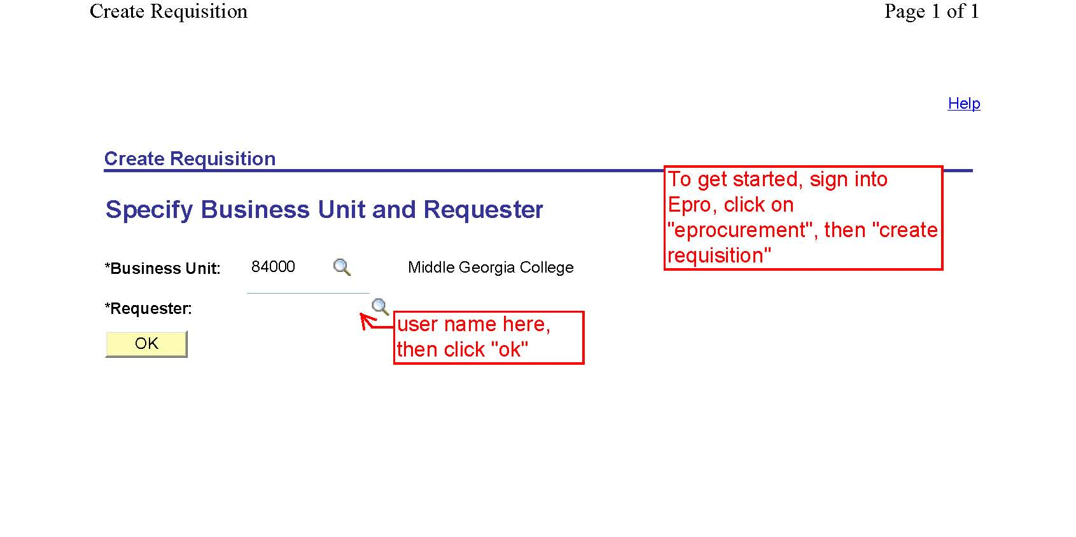
Create A Requisition

Slide 5
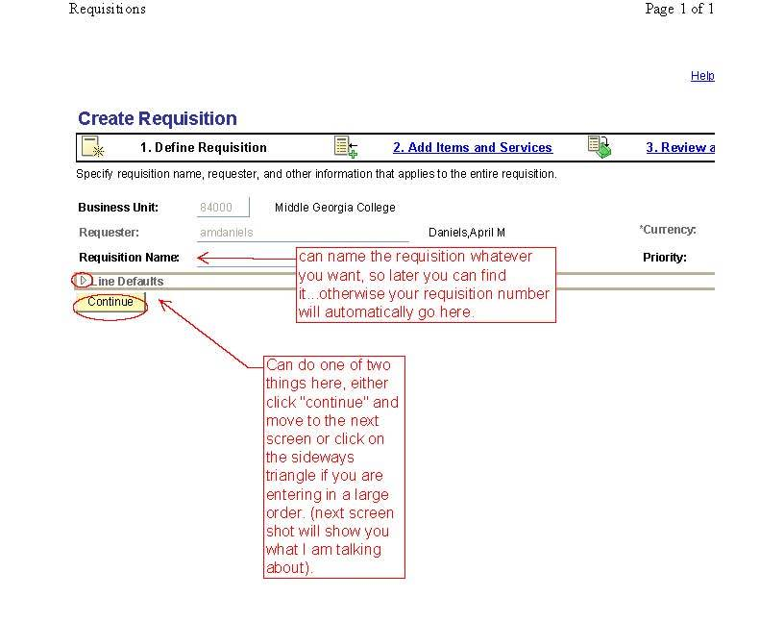
Create a Requisition

Slide 6
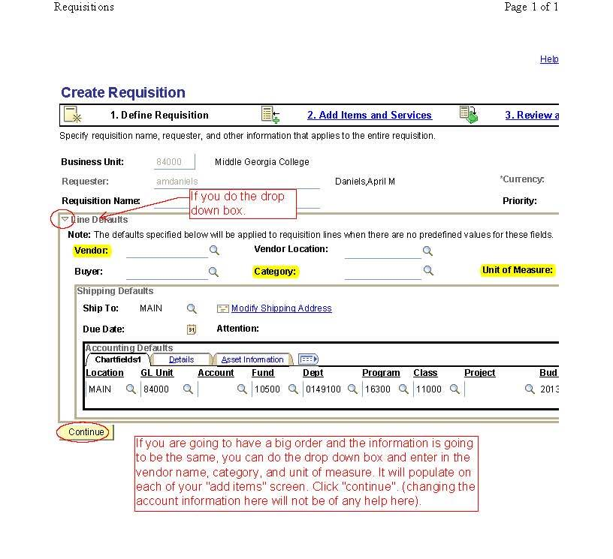
Create A Requisition

Slide 7
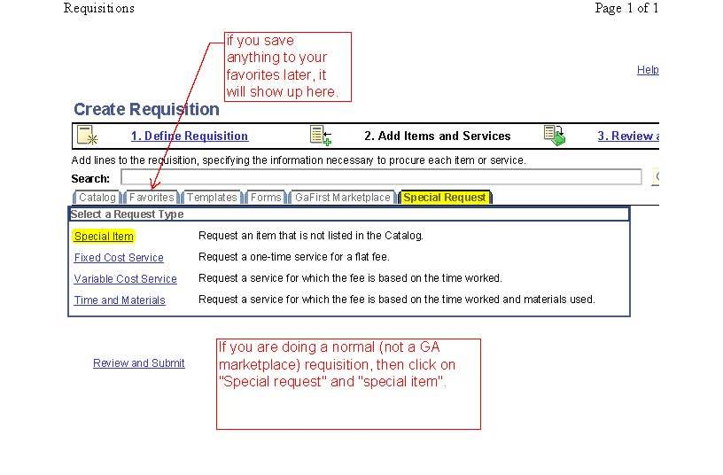
Create A Requisition
Select The GaFirst Marketplace tab for SWC orders.

Slide 8
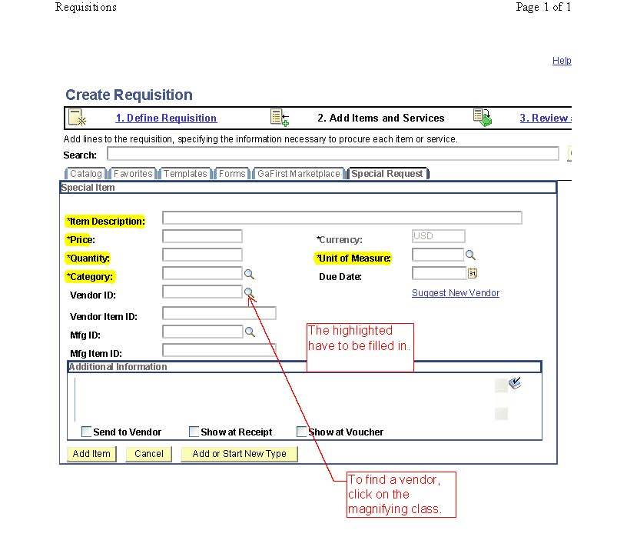
Create A Requisition

Slide 9
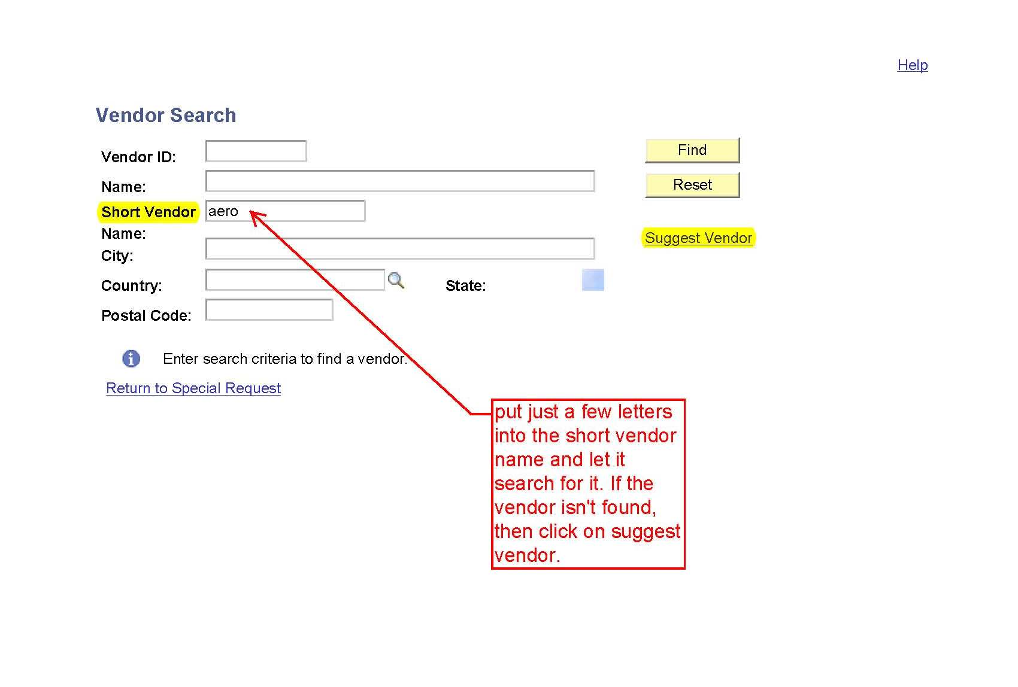
Create A Requisition

Slide 10
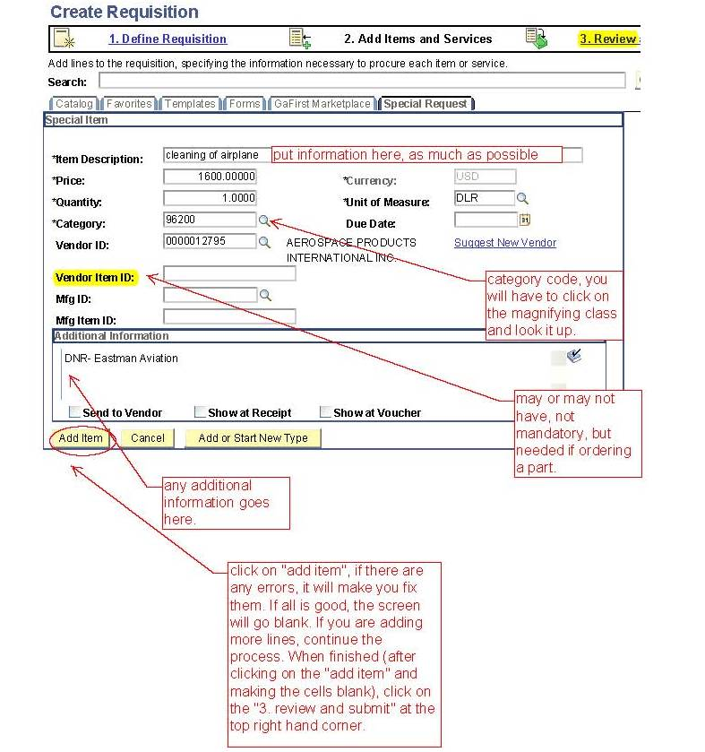
Create A Requisition

Slide 11
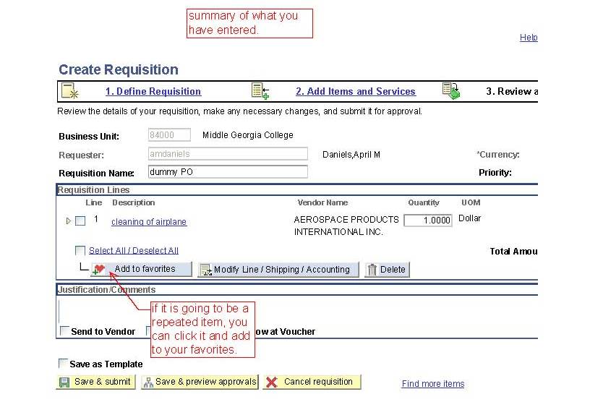
Create A Requisition

Slide 12
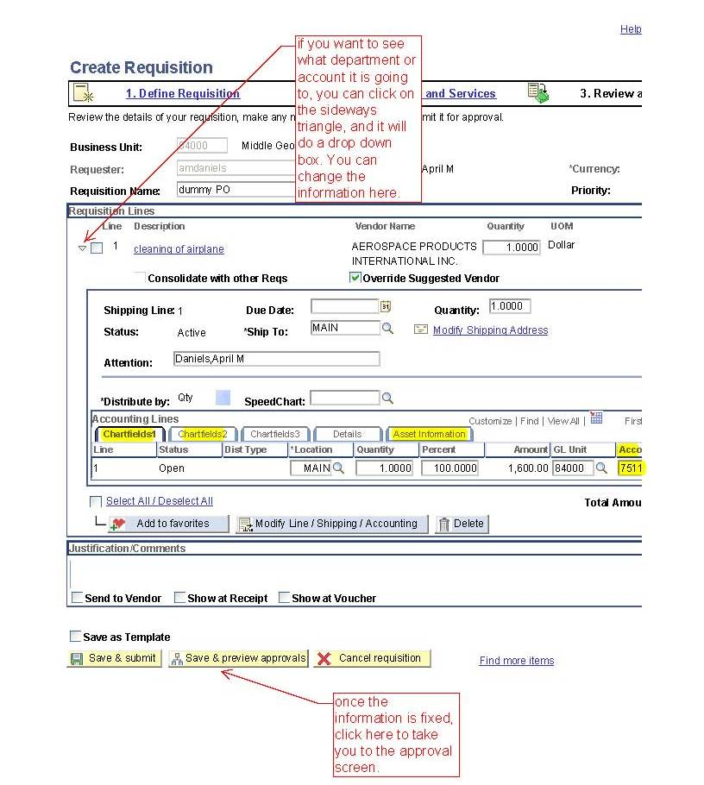
Create A Requisition

Slide 13
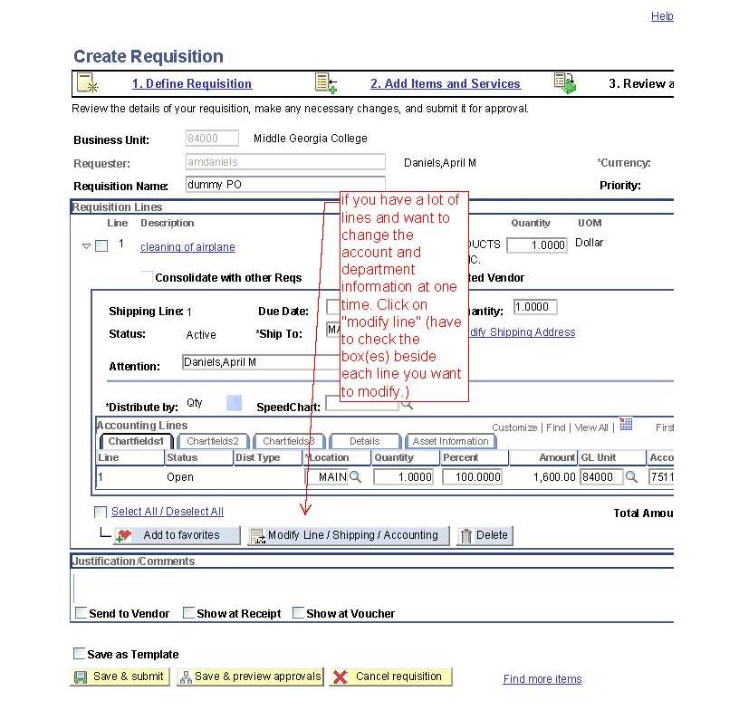
Create A Requisiton

Slide 14
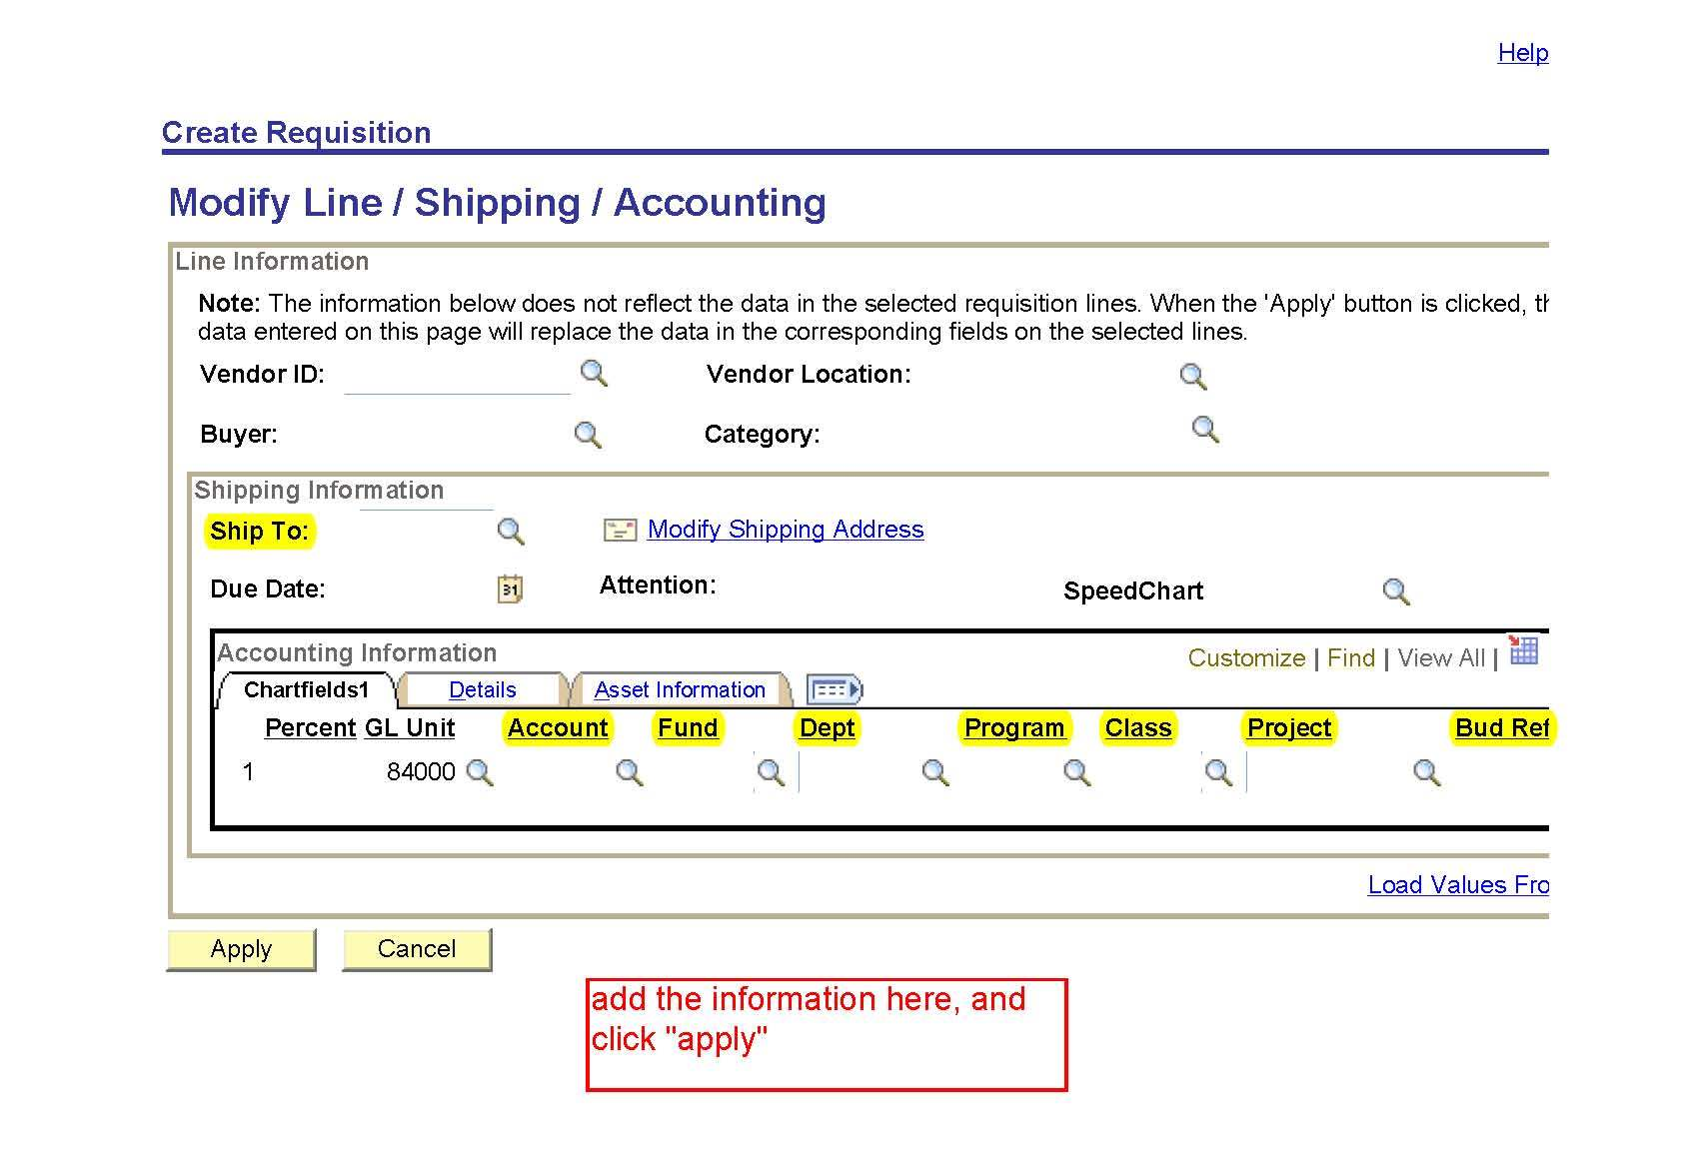
Create A Requisition

Slide 15
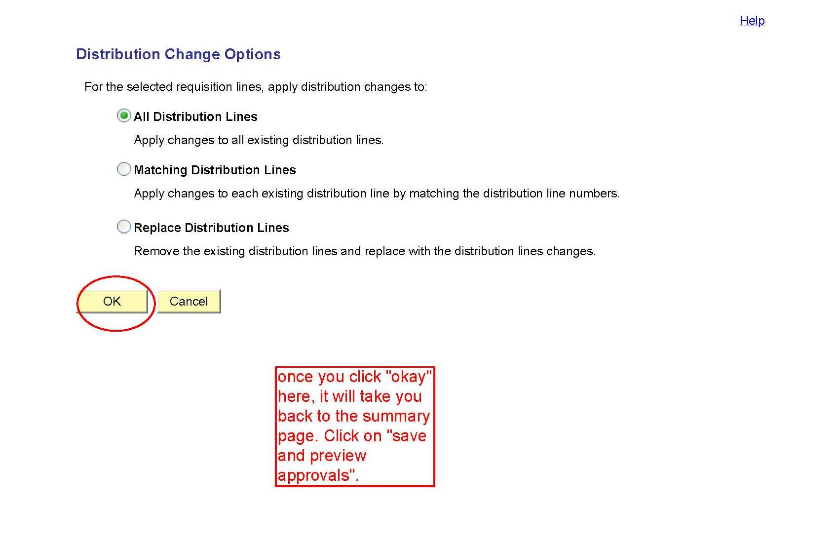
Create A Requisition

Slide 16
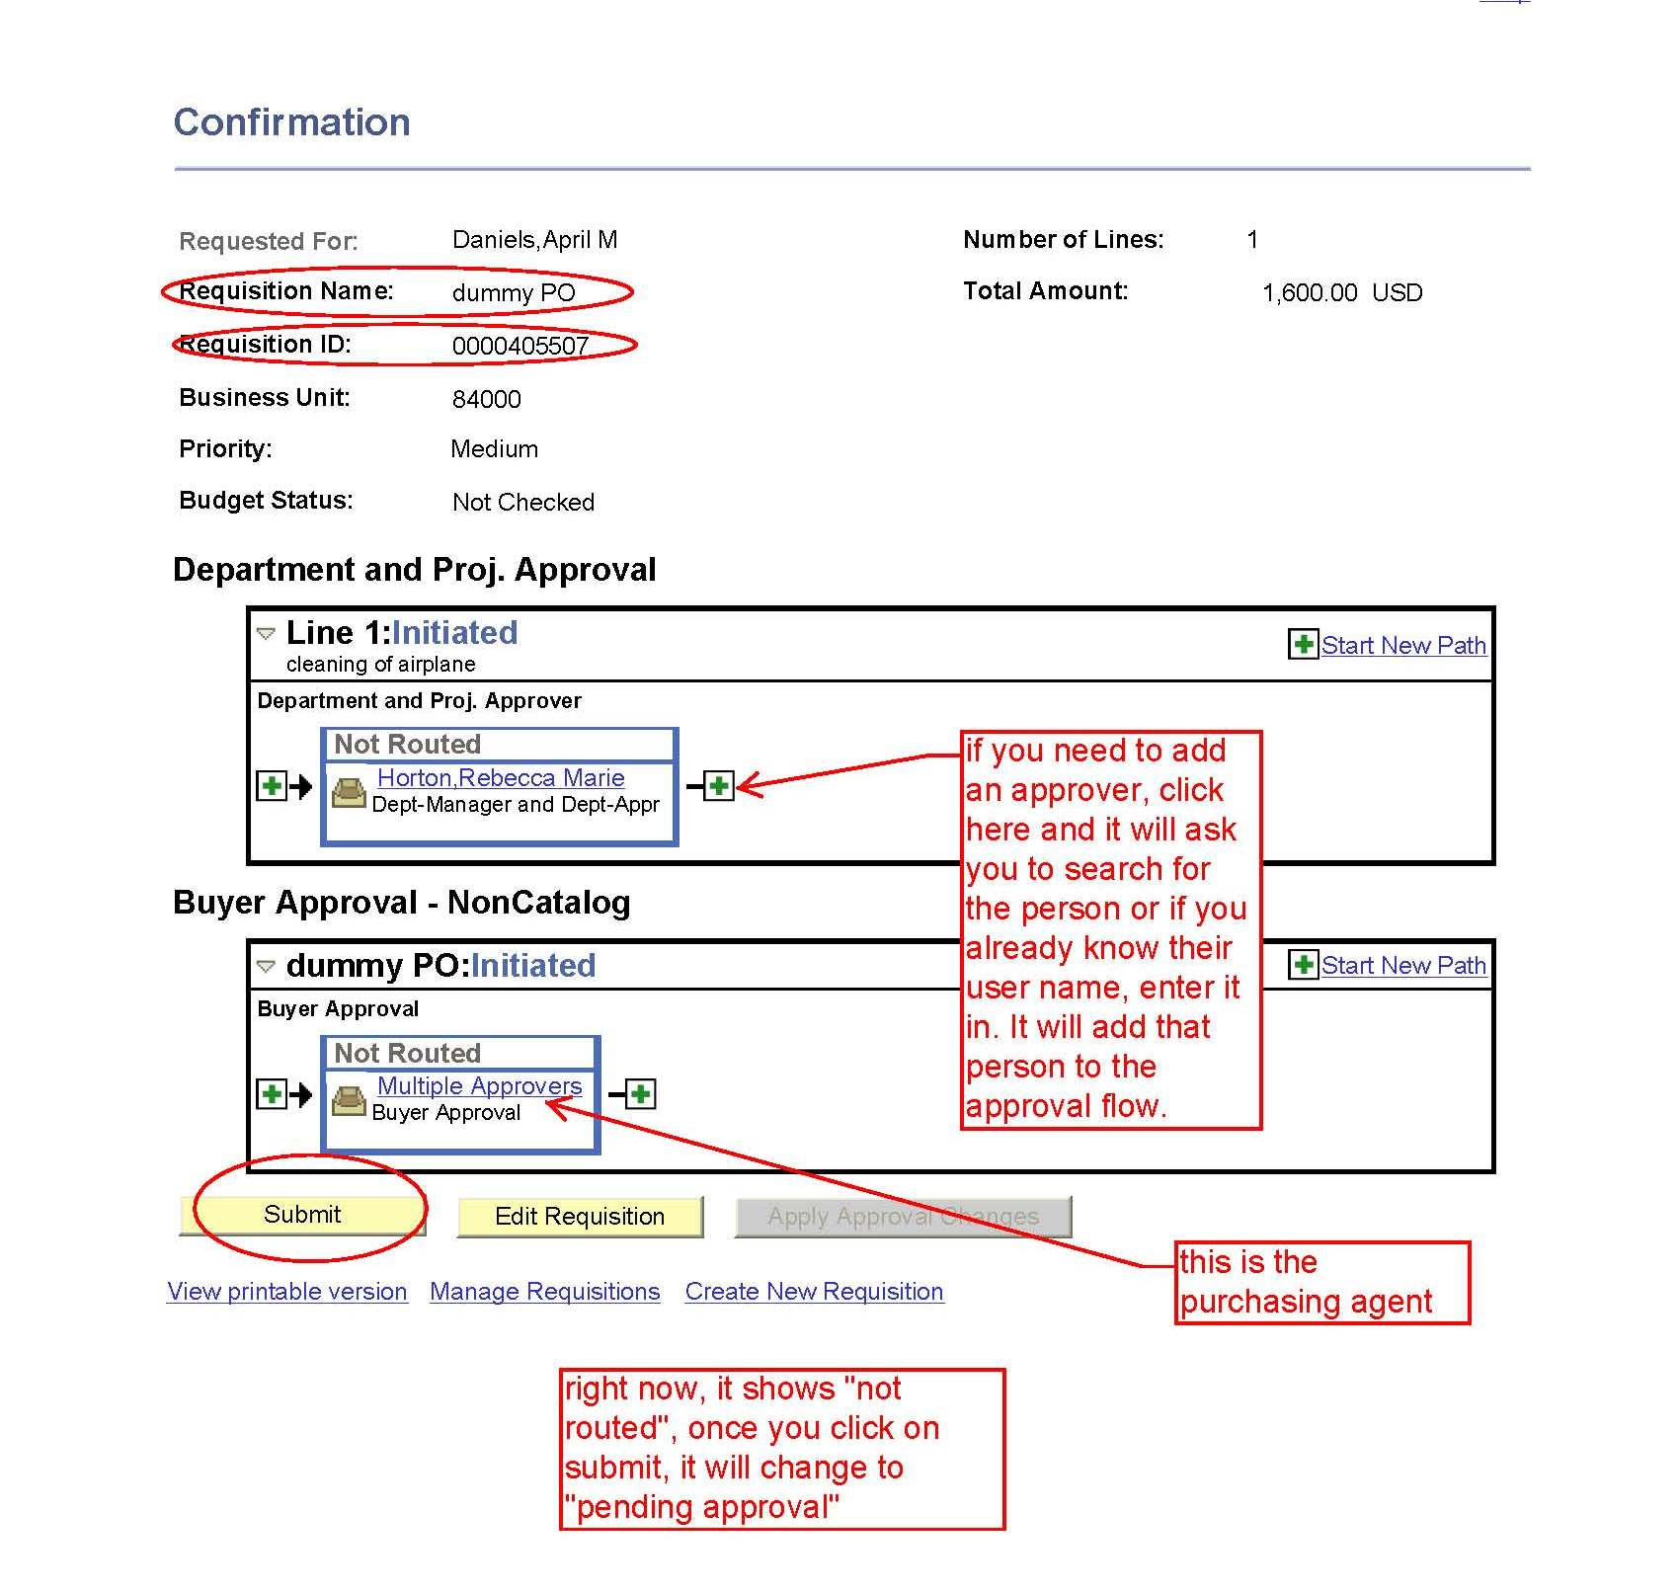
Final Step

